Slide 1
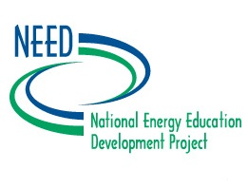
Energy from the Sun Workshop
Emerging Technologies and Current Solar Energy Research

Slide 2
Goals of Solar Technology Research
Improve efficiency
Improve overall cost and cost-per-kWh
Reduce impact of materials used
Improve viability in less sunny conditions

Slide 3
Areas of Research and New Technology
Passive solar heating
Active solar water heating
Electrical power generation
Concentrated solar
Photovoltaics
Notes:
Even though passive solar design has already been shown to be efficient, more research is being done to perfect the designs used, and to find materials that work well while maintaining aesthetic and design standards people desire in their homes.
Because solar water heating tends to be more expensive in the short-term than using natural gas for heating water, companies are finding ways to reduce the cause of residential water heating systems. Currently, the payback period is five to seven years, depending on location.
Most of the current research is in making solar energy more efficient and practical. Concentrated solar systems are being perfected for use in colder climates. Photovoltaic research is focused on improving efficiency, cost, weight, and durability of PV arrays and modules.

Slide 4
Newer Technologies
Solar Thermal Vacuum Tubes
Solar Thermal Troughs
Solar Stirling Engines
Tracking Solar Heliostats
Thin-film Flexible Photovoltaics
Multi-junction Photovoltaics
Vehicle-to-Grid Technologies
Space-based Photovoltaics

Slide 5
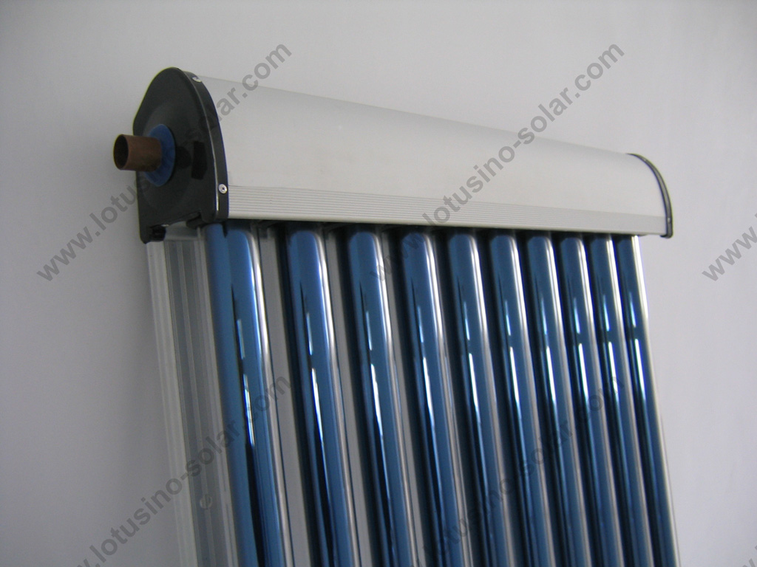
Solar Vacuum Tubes (water heating)
Notes:
A clear glass tube surrounds a dark tube. A vacuum exists between the dark tube and the clear glass, reducing heat transfer and energy loss. The dark tube contains a fluid that is pumped to a heat exchanger to heat water.

Slide 6
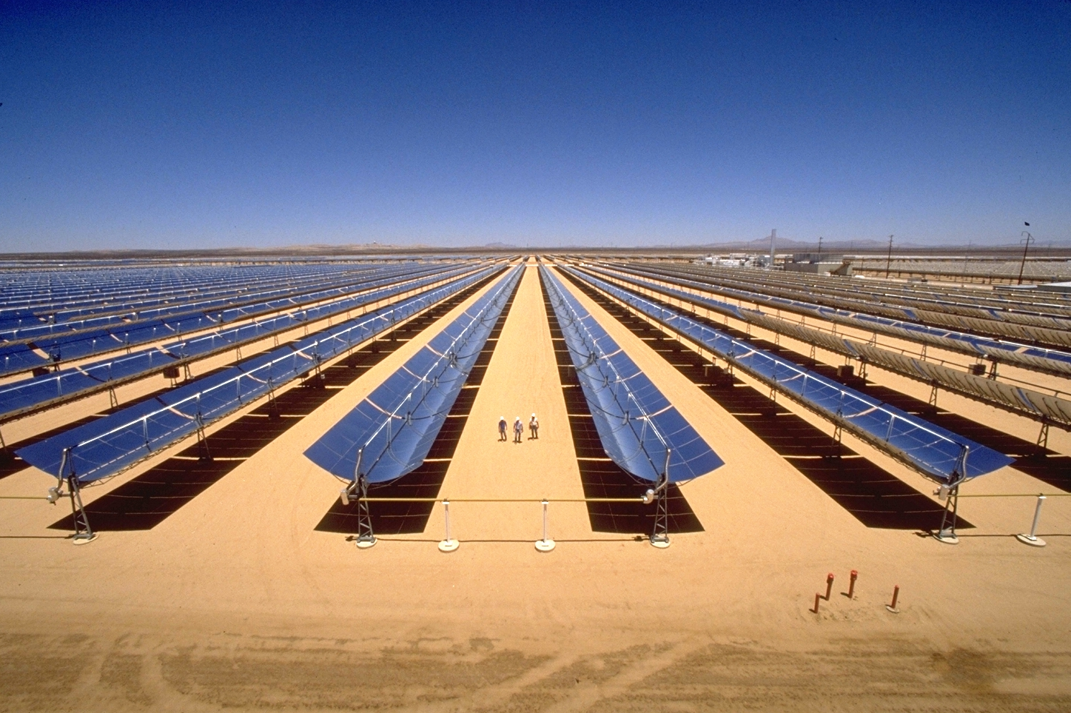
Trough Concentration (Kramer Junc.)
Notes:
Parabolic trough systems are expensive. Current research lies in the following areas:
Improved reflectivity of parabolic mirrors
Reduced manufacturing cost of troughs
Self-cleaning (coatings)
Replacing two-tank systems with one-tank thermocline systems
Reducing costs of production and integration to be competitive with other energy sources

Slide 7
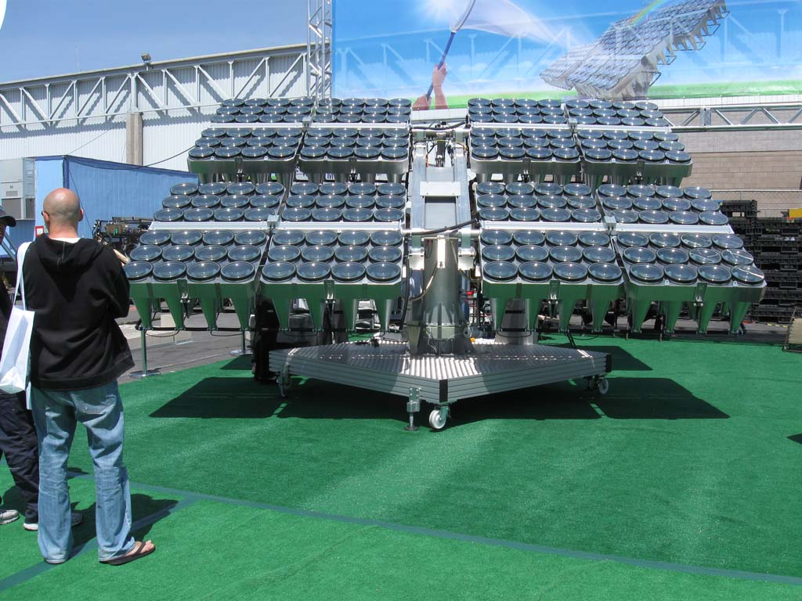
Concentrated Photovoltaics
Notes:
Concentrated photovoltaics focus light onto PV cells with lenses or mirrors. The PV cells used are high-efficiency and typically much more expensive than conventional PV systems. However, because the light is focused on the PV cell, a smaller cell or array can be used, keeping costs down.
Concentrating photovoltaic technology offers the following advantages:
Potential for solar cell efficiencies greater than 40%
No moving parts
No intervening heat transfer surface
Near-ambient temperature operation
No thermal mass; fast response
Reduction in costs of cells relative to optics
Scalable to a range of sizes.

Slide 8
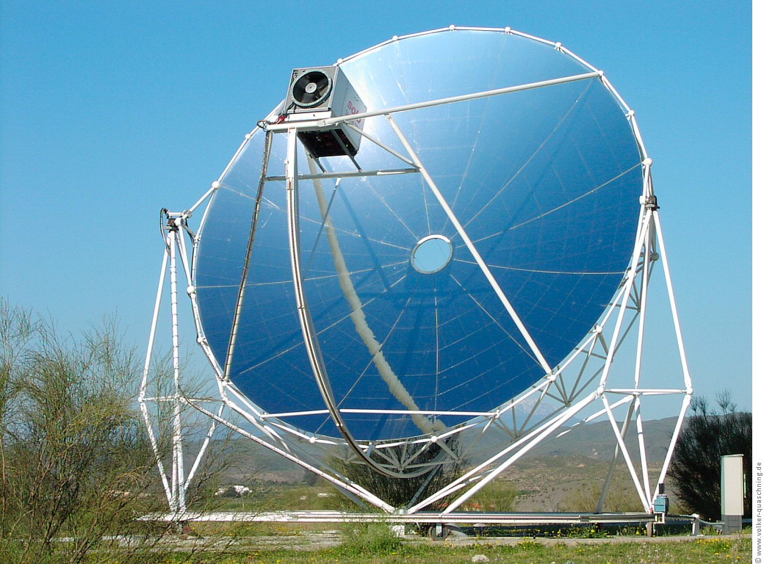
Solar Stirling Engine
Notes:
Focusing solar radiation onto a stirling engine will cause it to rotate the fly wheel, and connecting it to a turbine will generate electricity.

Slide 9
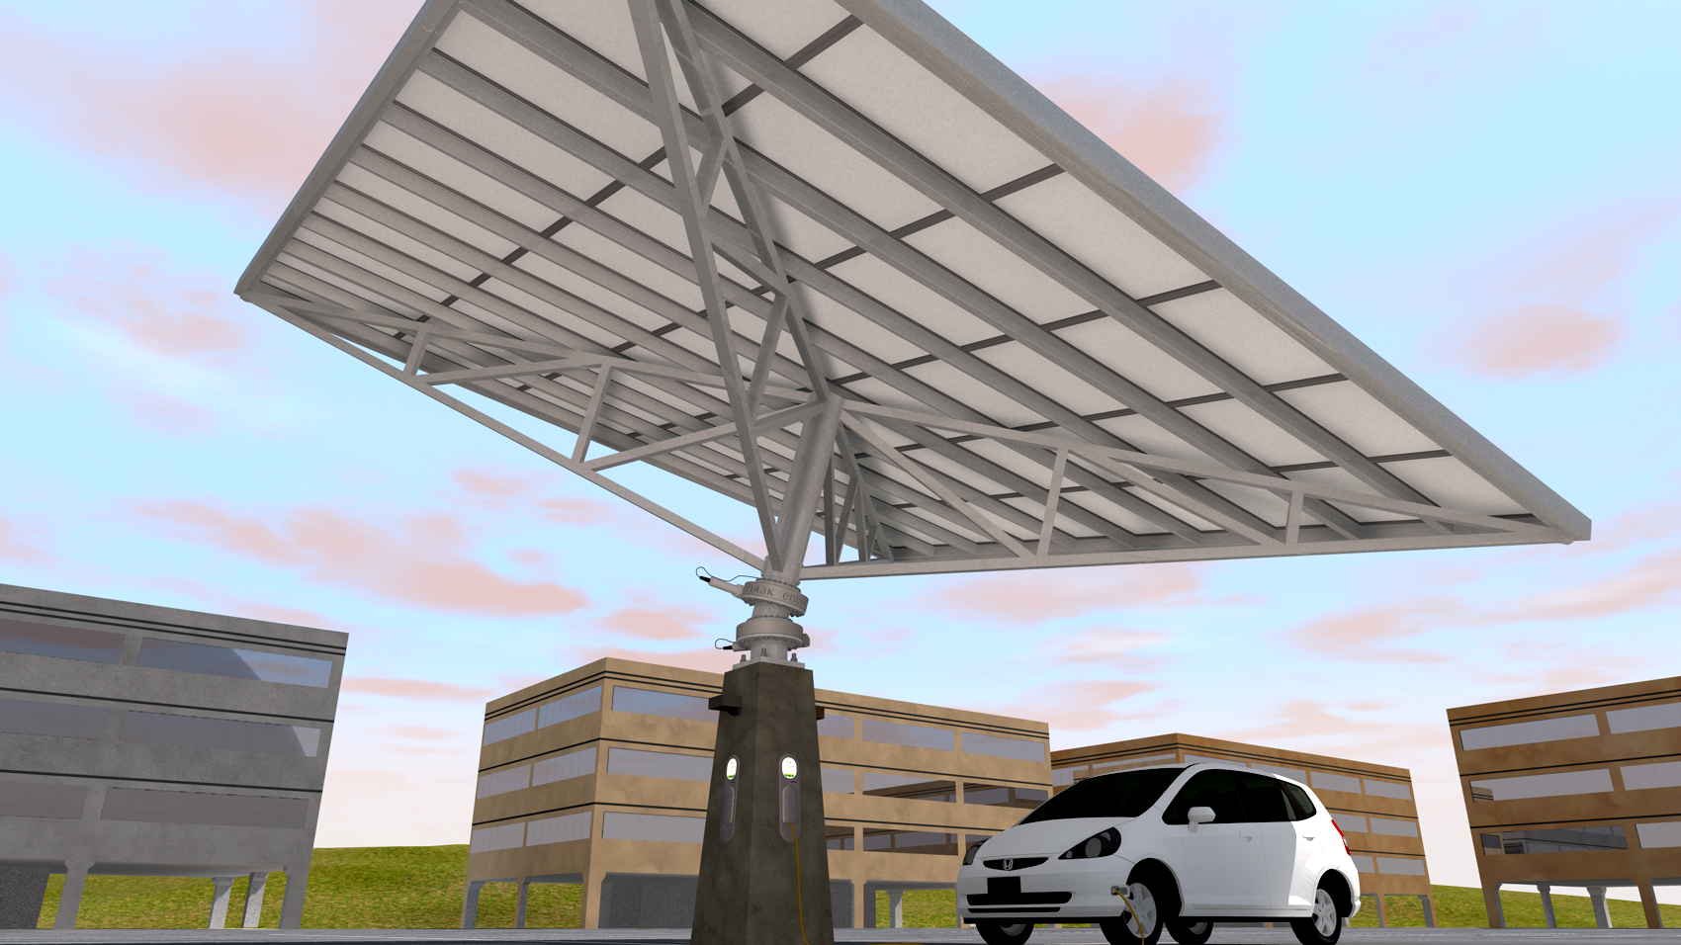
Tracking Photovoltaic Heliostats
Notes:
Tracking PV heliostats move on two axes to accommodate both the tilt of the earth throughout the year as well as the rotation of the earth throughout the day. The angles are adjusted to ensure the maximum intensity of insolation is achieved.
The major benefit of tracking photovoltaics is that they can generate more energy per acre than fixed-angle photovoltaics. Even though they cost more to manufacture and install, the increased amount of energy they can produce reduces the payback period.

Slide 10
Improving Photovoltaics
First-generation (silicon)
Thin c-Si via epitaxial growth
Crystallized polysilicon layers
Nanoscale silicon
Second-generation (“thin film”)
Less efficient, more flexible and less expensive than 1st gen
CdTe and CIGS
Third-generation
Solar ink, solar dye, conductive plastic
Notes:
Silicon crystal photovoltaics continue to be the primary materials used in PV systems installed today. Research at NREL and other facilities is focusing on three major areas:
Thin crystalline silicon acquired via epitaxial growth. Gaseous silicon compounds are passed over a very hot substrate and the crystals that form are in a controlled orientation. Finding high efficiency and low-cost substrates for thin film applications are key.
Crystallized polysilicon layers
Nanoscale silicon
Scientists at NREL are also studying new, non-crystalline materials for manufacturing photovoltaics. Organic photovoltaic (OPV) cells have an extremely broad application potential because of their flexibility, ability to absorb in different colors, and make efficient transparent devices. These properties make OPV attractive for integration into building design.

Slide 11
Notes:
Elements are arranged in the periodic table in increasing numbers of protons. The groups – vertical columns – align according to the number of valence electrons in each element. Thus, elements in the same group have the same number of valence electrons, and very, very similar properties.
Pretty cool, huh?

Slide 12
Notes:
Electron arrangement of carbon atom (green and orange subshells). Note that the electrons spread themselves out evenly among all the orbitals. This is described by Hund’s Rule. There are two electrons in the innermost energy level, and four in the second energy level.
Silicon has a similar electron arrangement, with its valence shell being outside the one shown here for carbon. The electrons arrange themselves in silicon in the third layer (burgundy dashed line) in the same way that they do in carbon in the second layer – one per orbital.

Slide 14
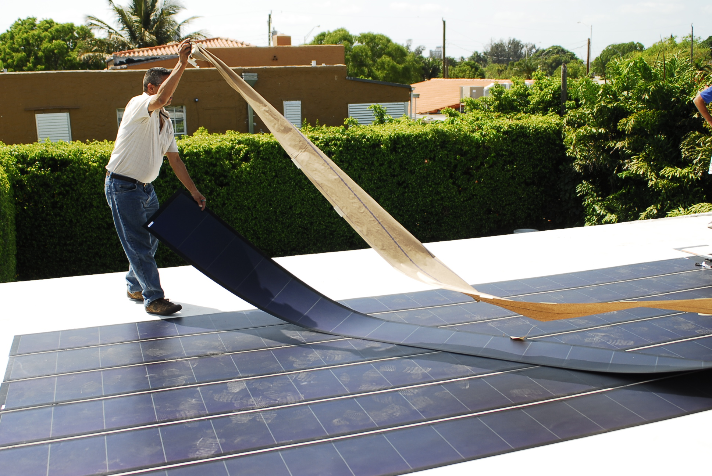
Flexible Thin-Film Photovoltaic
Notes:
Conventional photovoltaics are housed underneath a piece of glass. They are heavy, cumbersome to move, and can break. They certainly cannot be walked on as shown here. This photograph shows the installation of a thin-film PV system. Thin-film, or second-generation PV, systems are flexible, lightweight, and can be used in a variety of applications, including within roofing shingles, on rooftops, in skylights, and even on building façades.
Two materials currently researched are cadmium-telluride and copper indium gallium diselenide. CdTe has a simple composition so it’s easy to manufacture, and has a conversion efficiency of about 17%. CIGS is a little more complicated, but is about 20% efficient.

Slide 15
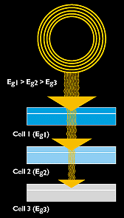
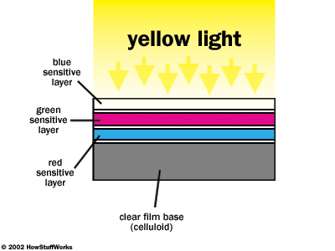
Multi-junction photovoltaic cell
Color Film
Multi-junction Photovoltaics
Notes:
Multi-junction photovoltaic cells work on a similar principle as did color film of days past. Color photographic film contained three layers that were each sensitive to different “colors” of light, and when combined, produced a complete image.
Multi-junction PV cells have multiple layers, each which is sensitive to its own wavelength. Thus, rather than “wasting” all the other wavelengths of light that reach it, multi-junction photovoltaics can generate more electrical power from a single exposure to sunlight than traditional photovoltaic cells.
The most promising materials being used in this application are elements from groups 13-15, which under the old group numbering system were groups IIIB – VB. This type of multi-junction photovoltaic is called a III-V multi-junction photovoltaic because most contain some combination of gallium, indium, phosphorus, germanium, and arsenic.

Slide 16
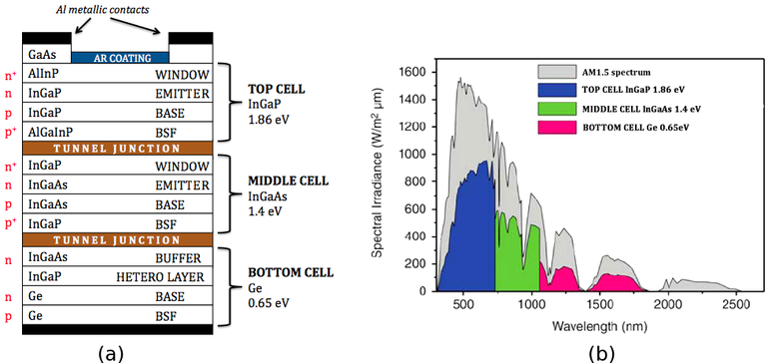
Multi-junction Photovoltaics
Notes:
The diagram on the left shows how the different layers (n-type and p-type) and the possible materials within them can be constructed.
The diagram at right shows how each of these layers absorbs different wavelengths of light. The top cell is sensitive to light in the blue range, which is also the most high-energy and shortest wavelength range of visible light. The middle cell is sensitive to photons in the green visible region, and the bottom layer is sensitive to the longest wavelengths, the reds.

Slide 17
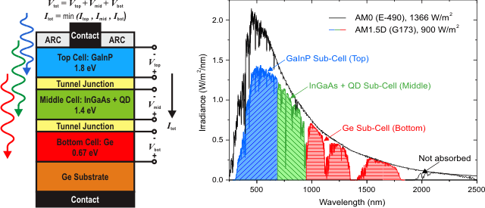
Multi-junction Photovoltaics
Notes:
This diagram is another way of looking at multi-junction photovoltaics.
While single junction photovoltaics, such as conventional silicon photovoltaic cells, have a maximum theoretical conversion efficiency of 34%. However, using the same mathematical methods, multi-junction photovoltaics have a maximum theoretical conversion efficiency of 87%.

Slide 18
Improved Efficiencies
Notes:
A historical perspective regarding photovoltaic development and achieved conversion efficiencies.

Slide 19
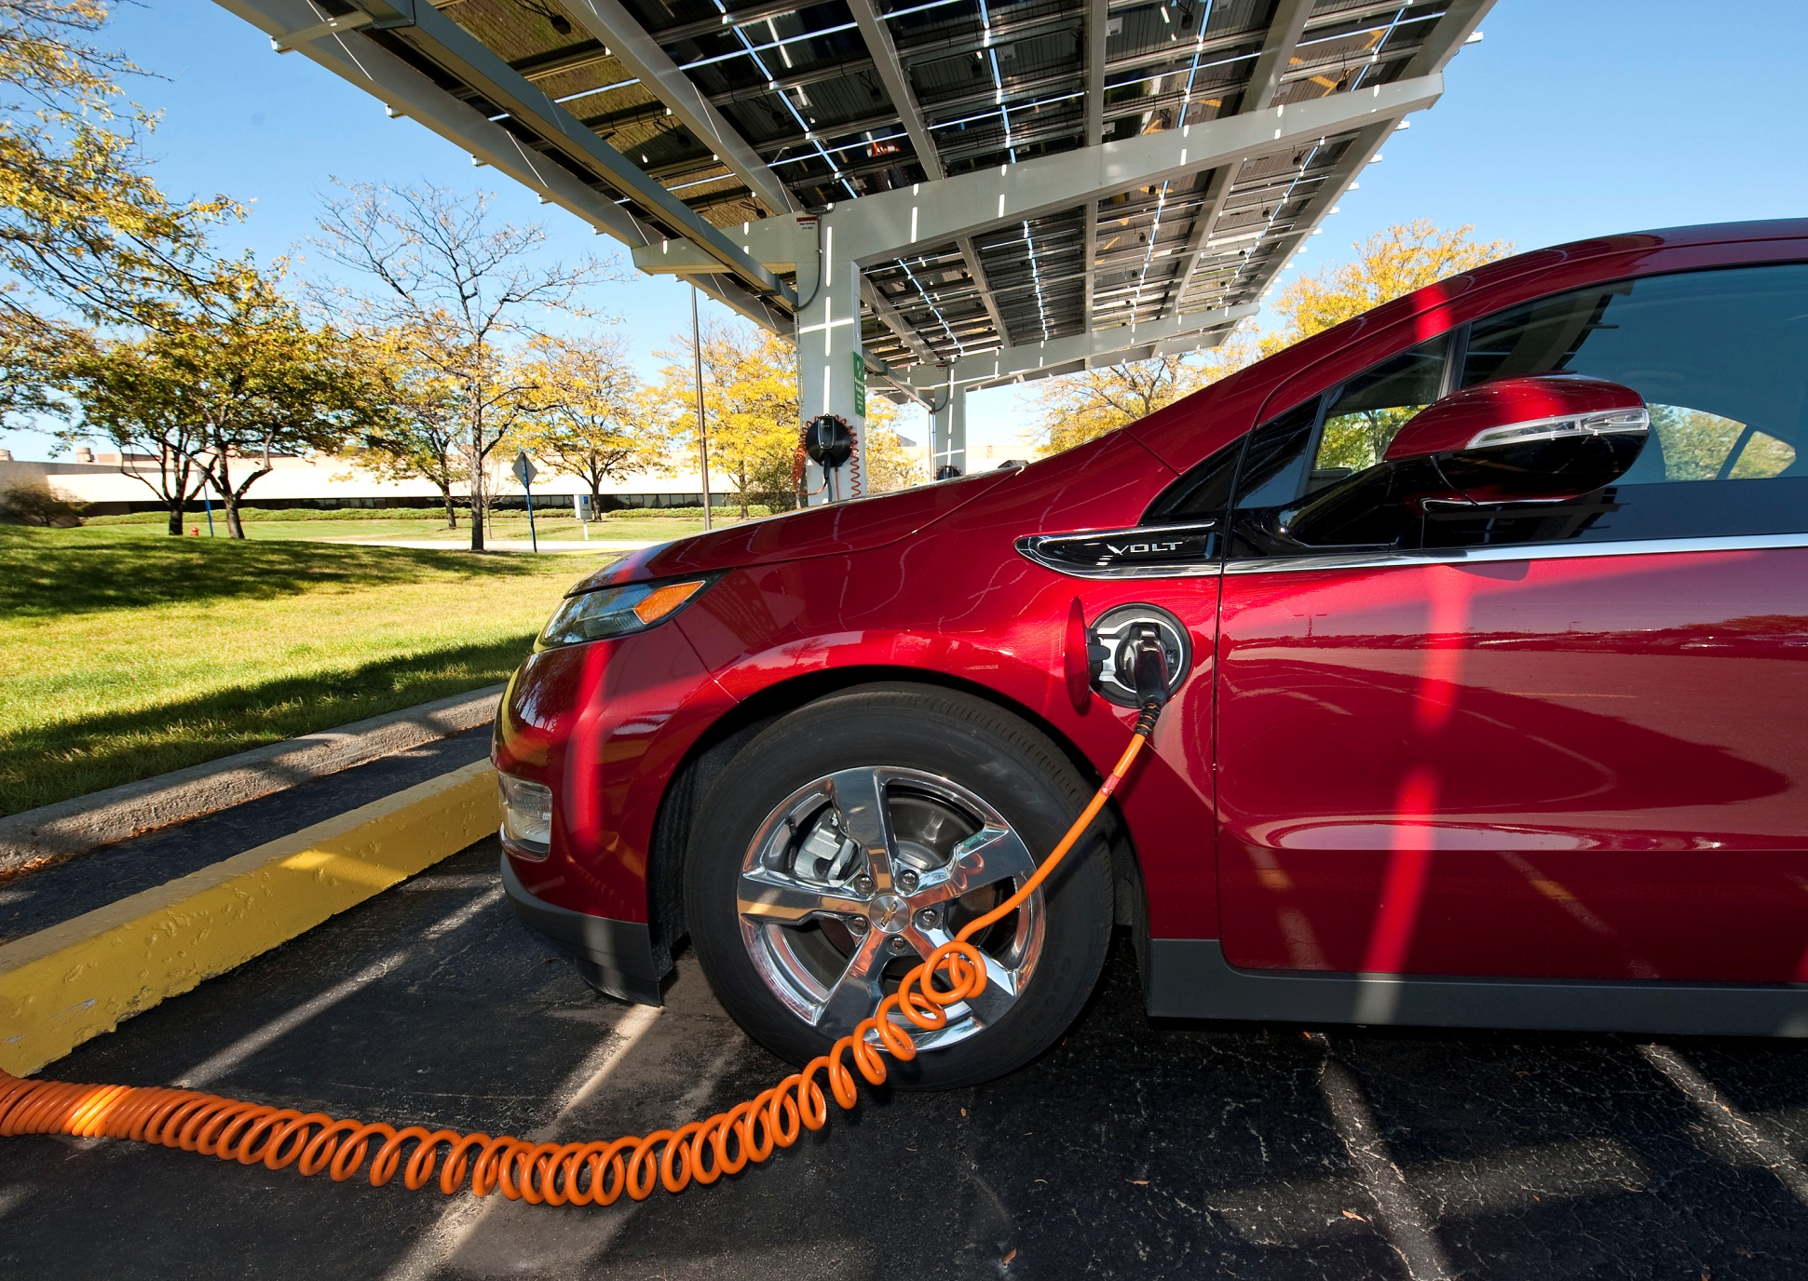
Photovoltaic Electric Vehicle-to-Grid
Notes:
Imagine being able to recharge your electric car while at work, and having it parked beneath a sun-shading photovoltaic panel! With more electric vehicles available on the market, more recharging stations are going to be necessary. Furthermore, as California moves to increase renewables to 33% by 2020 and decrease emissions to 2009 levels, while at the same time electric vehicles place greater demands on the grid, photovoltaic charging stations like the one pictured here may become more and more common. Many people shopping for PV systems for their homes are including recharging capacity in sizing their systems. Photovoltaics are going to continue to be a major factor in reaching goals for emissions and green energy production.

Slide 20
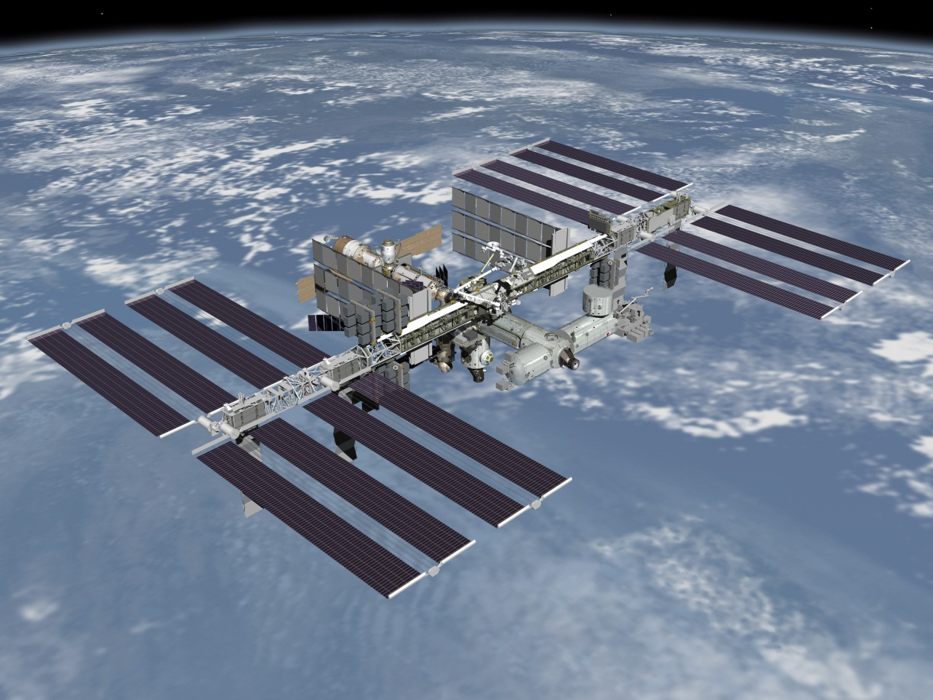
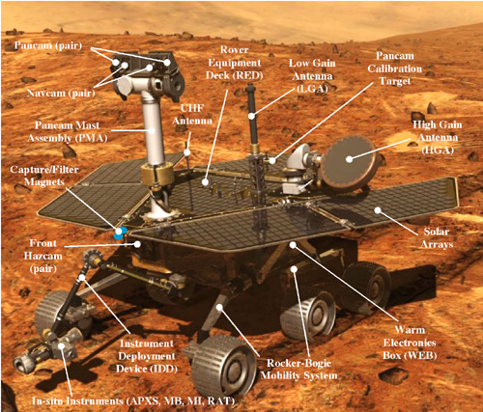
Space-based Solar Photovoltaics
Notes:
In space, not only can no one hear you scream, the Energizer Bunny doesn’t come by with new batteries for your electronics. High-efficiency, reliable photovoltaics are used to power satellites, the International Space Station, and even the Mars rover.

Slide 21
For More Information
If you have questions, we have answers:
www.need.org – our website
info@need.org – questions about NEED
cturrel@need.org – questions about this workshop
1-800-875-5029 – NEED main office phone number

