Slide 1
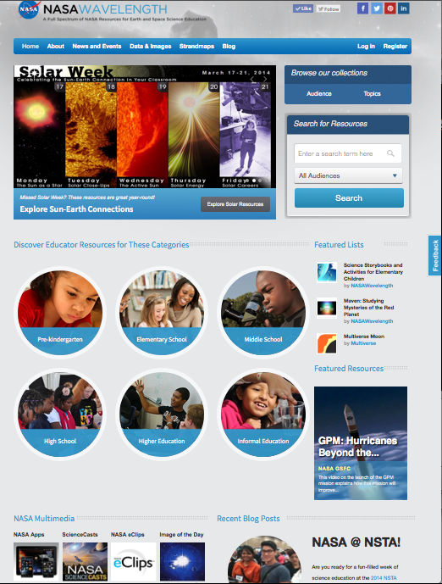
NASAWavelength.org
Reviewed collection of
2,000+ Earth and Space
Science education resources
Target audience: Educators
K-12
Higher Education
Out-of-school
Multiple Pathways
to Discover and Connect
Resources
(e.g., AAAS Benchmarks)
Notes:
NASAWavelength.org is a peer-reviewed (reviewed by scientists and educators) collection of over 2,000 NASA Earth and space science education resources. Our target audience is educators at all levels – K-12, higher education and educators in out-of-school programs.
When you go to the Wavelength home page (NASAWavelength.org), you’ll immediately see the kinds of resources that are in the collection and multiple pathways through the collection. At the top are banners for featured collections (rotates between 4 featured collections that are related to current events (here you see a banner for Solar Week – takes you to the collection of Solar Wee activities in Wavelength), or topics of current interest (e.g., we featured resources related to comets when Comet ISON was visible, resources for girls and STEM during Women’s History Month, or educational resources related to hurricanes during the spring or early fall when hurricane season starts or at the beginning of the school year). At the top right – you can browse the collection by broad topic or audience, or enter a keyword or phrase.
Mousing over the “Audience Bubble” in the middle of the page shows the number of items in the collection for that level, or clicking on the bubble brings up a list of resources that you can then apply several filters to narrow down your search (e.g., topic, resource type, instructional strategy, materials cost). You can also see featured lists of collections that users have created and featured products from the collection.
At the bottom of the page are links to the broader NASA family of resources- NASA Apps, NASA Science Casts (short 2-4 min videos on current science topics, NASA eCips (additional videos with separate versions for elementary, middle and high schools students). In the bottom right is our blog, launched March 15, 2014, where we can talk in more depth about educational resources and projects where you can get involved. A recent post looked at finding and supporting the “E” in STEM – resources in NASA Wavelength to support Next Generation Science Standards and engineering.
Resources in the collection are all aligned to standards – AAAS Benchmarks for science literacy. Clicking on the list to strandmaps in the top navigation bar takes you to a landing page where you can browse the collection by AAAS Strandmaps for Science Literacy. You’ll also find in the top nav bar links to “News and Current Events” (calendar of upcoming events like workshops) and to a section on “Data and Images” where you can find resources to supplement instruction at all levels – from introductory resources that require no special tools or software, to full research datasets for higher education.

Slide 2
Notes:
Visit NASAWavelength and follow us on our social media accounts on Twitter (@NASAWavelength) or Facebook, to learn about the latest NASA resources, projects and activities where you can get involved.

