Slide 1
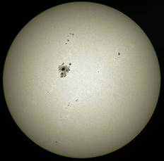
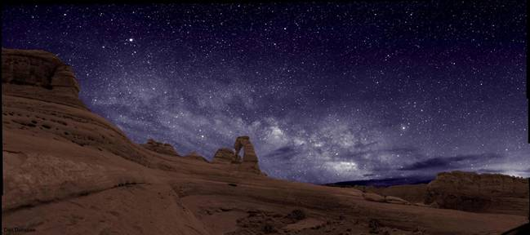
What is the Sun?
The Sun is a Star, but seen close-up.
The Sun is giant ball of very hot, mostly ionized hydrogen gas that shines under its own power.
Notes:
The Sun is a star, but because it is closer than other stars, it appears larger than the other stars. The fact that the Sun is a star was theorized by several ancient astronomers, but the proof of this did not come until the late 19th/early 20th century when the light from the Sun and stars was split into its component colors (spectra), recorded, compared and found to be the same.
The Sun is so hot from nuclear fusion that the heat removes electrons from most of the Sun’s gas, leaving an electrified ball of gas known as a plasma. The Sun is large (109 times Earth’s radius). Its equator rotates once every 27 days but its poles once every 31 days. Its power output is huge and the surface temperature is very hot (water boils at 373 K). The Sun is incredibly massive - hundreds of thousands of times more massive than Earth. It is made up of mostly Hydrogen, some helium, and a very small amount of heavier elements. It is a middle aged star at 5 billion years old.

Slide 2

What is the Sun?
The Sun IS NOT an average, yellow star.
Notes:
It is often said that the Sun is an average, yellow star. The Sun is neither average nor yellow. It is white and it is above average. There are far more smaller, cooler, less massive stars than there are larger, hotter, more massive stars.

Slide 3
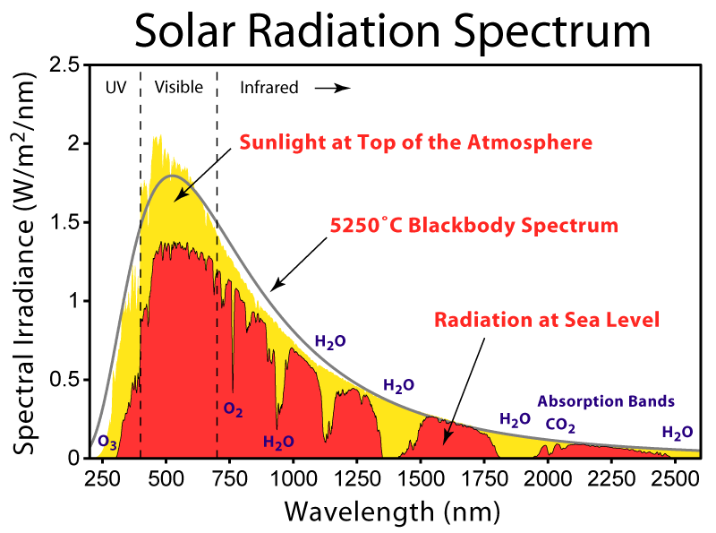
Surface Temperature
5800 K
Notes:
The peak of the solar spectrum is not in the yellow it is more in the cyan (blue-green) region of the visible spectrum. A 5,800K blackbody is the best fit to the solar spectrum. The Wien’s law peak wavelength for this temperature is 500nm (blue-green).
A star with a peak in yellow wavelengths (617nm) would be at a temperature of 4700K. These are K-type stars, with 0.75M_{Sun}.

Slide 4
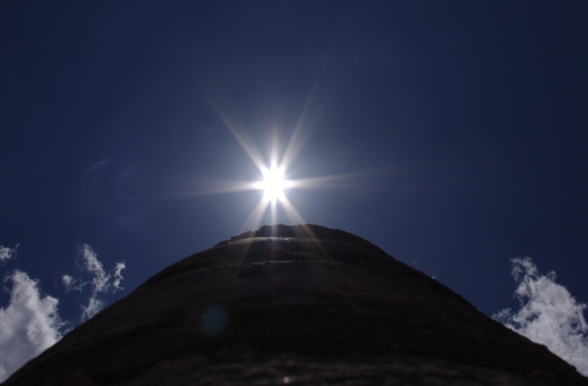
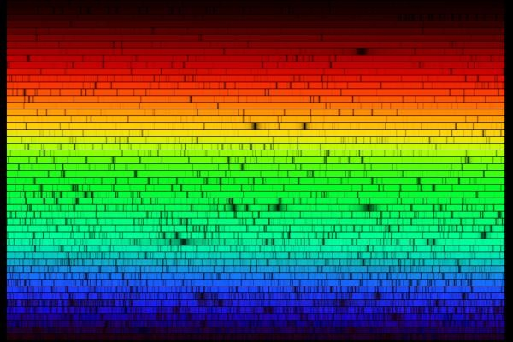
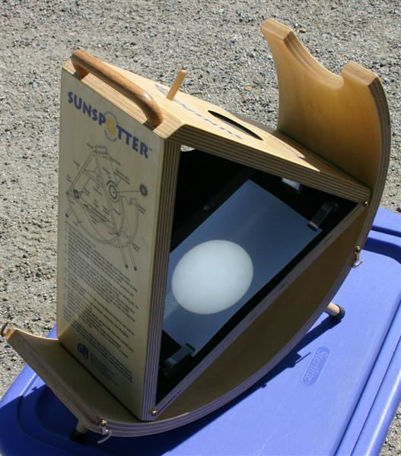

The Sun is White
The Sun produces all the colors of the rainbow in roughly equal amounts, which is white light.
If the Sun were yellow, then white T-shirts would look yellow in the mid-day sunshine.
When you observe the Sun safely, by projecting its image through a pinhole camera or a telescope, you see that it is white.
Don’t stare directly at the Sun!
The UV radiation can damage your eyes.
Notes:
But to the eye, the Sun appears white (at least when it is high in the sky without significant atmospheric reddening). It’s bright enough across the visible spectrum to essentially saturate our eyes, which is perceived as white.
The image in the upper left is a photo of the Sun taken at Zenith passage at Chichen Itza, Mexico. It’s color is clearly white!
The image on the upper right is a spectrum of the Sun. The dark lines are elements in the Sun’s atmosphere absorbing some of the light. At the surface temperature of the Sun, it puts out roughly the same energy at all visible wavelengths of light. The Sun’s peak energy output is at about 500 nm, which is a blue-green color, not yellow.
It is difficult to look directly at the Sun, which is good because extended exposure to the intense UV radiation from it can damage the retinas of the eye. The safest way to observe the Sun is by projecting its image through a pinhole camera (a simple pinhole in any stiff material) or by projecting it through a telescope into a shaded area. The image on the lower right is of the Sun projected through a contraption called a sunspotter, which is basically a small telescope without the tube. Never, ever look at the Sun directly through a telescope unless it has a special filter. The focal point of even a small telescope pointed at the Sun has enough energy to ignite flesh on fire!
When we can stand to look at the Sun it is usually low in the sky and atmospheric scattering has removed much of the bluer portion of the spectrum, making it appear more reddish, orangish, and yes, sometimes yellowish.
Drawing a yellow Sun is a cultural phenomenon as well. Ask a Japanese child to draw the Sun and they will draw a red circle.

Slide 5
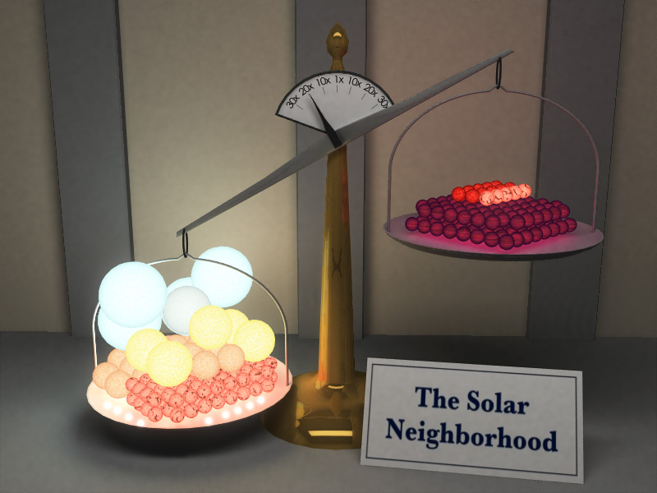
The Sun is Above Average
Most stars in the Universe are small, cool, low-mass dwarfs. The Sun is larger, hotter, and more massive than these.
There are stars that are much larger, very hot, and many times more massive than the Sun. But these stars are quite rare compared to the Sun or the low-mass stars.
The Sun is also not median, mid-range, or most frequent (mode) in the measures of size, temperature, brightness, or mass.
Notes:
There are far more smaller, cooler, less massive stars than there are larger, hotter, more massive stars.
Property Sun Range for Stars in the Milky Way relative to the Sun
Radius 696,000 km (109 times Earth’s radius) 1x10⁻¹ – 2x10³ (more smaller than larger)
Rotation Rate 27 days (equator) to 31 days (poles)
Luminosity 3.8 x 10²⁶ watts
(Power Output) (10 trillion times the power consumption of all Earth’s nations combined) 4x10⁻² – 9x10⁶ (more less luminous than more luminous)
Surface Temperature 5,800 K (average) 1.5x10³ – 3x10⁴ K (more cooler than hotter)
Mass 2 x 10³⁰ kg (300,000 times Earth’s mass) 8x10⁻² – 3x10² (more less massive than more massive)
Composition 70% Hydrogen, 28% Helium, 2% heavier elements (by percentage of mass)
Age 5 billion years (expected to live another 5 billion) 10⁵ – 10¹⁰ yrs

Slide 6
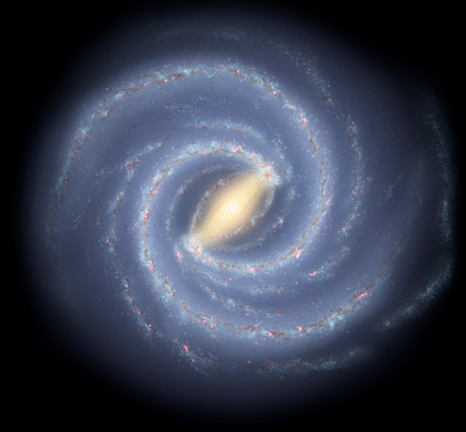
Properties of the Sun
Property | Sun | Range for Stars in the Milky Way relative to the Sun
Radius | 696,000 km (109 times Earth’s radius) | 1x10⁻¹ – 2x10³ (more stars smaller than larger)
Rotation Rate | 27 days (equator) to 31 days (poles)
Luminosity (Power Output) | 3.8 x 10²⁶ watts | 4x10⁻² – 9x10⁶ (more stars less luminous than more luminous)
Surface Temperature | 5,800 K (average) | 1.5x10³ – 3x10⁴ K (more stars cooler than hotter)
Mass | 2 x 10³⁰ kg | 8x10⁻² – 3x10² (more stars less massive than more)
Composition | 70% Hydrogen, 28% Helium, 2% heavier elements (by percentage of mass) | Typical for Pop I, Pop II stars are more metal poor
Age | 4.8 billion years of an expected 10 billion year lifetime | 10⁵ – 10¹⁰ yrs, More older stars than younger stars
Notes:
It is often said that the Sun is an average, yellow star. The Sun is neither average nor yellow. It is white and it is above average. There are far more smaller, cooler, less massive stars than there are larger, hotter, more massive stars.

