Slide 1
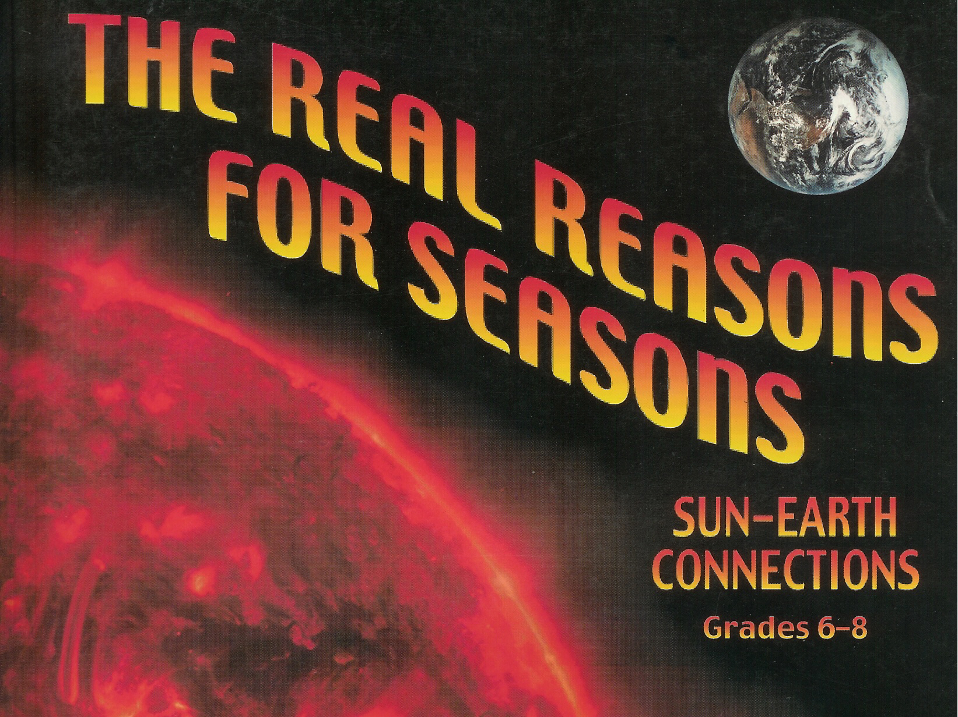

Slide 2
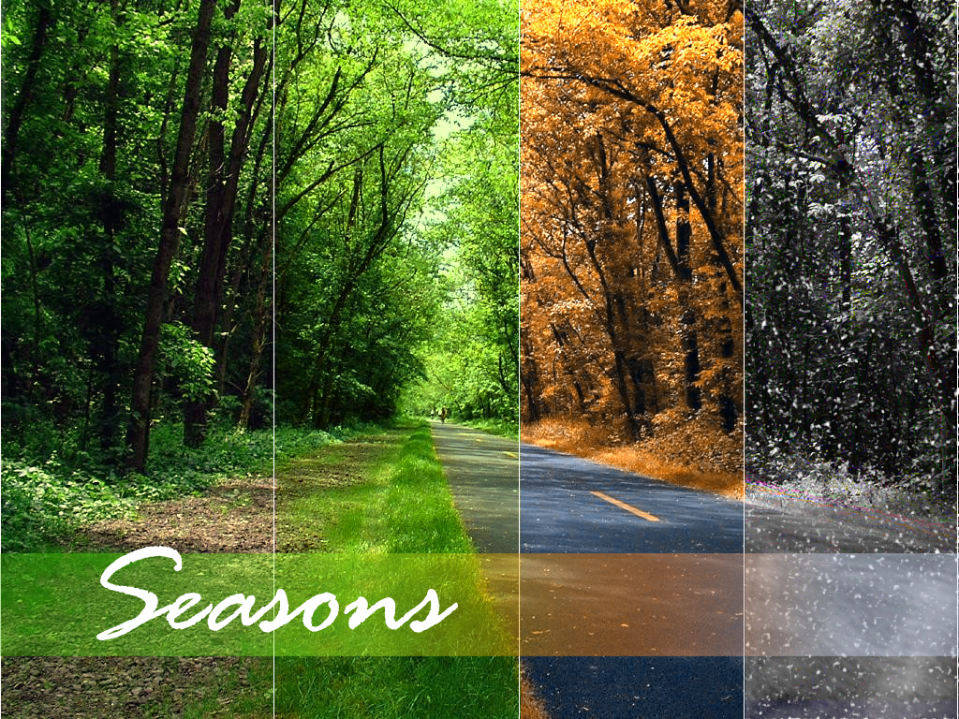
Activity 1: Name the Season

Slide 3
 | Biological (Life Changes) | Meteorological (Weather Changes) | Sociological: Holidays | Sports Events | School Events
Fall
Winter
Spring
Summer

Slide 4
Activity 2: Sun-Earth Survey

Slide 5
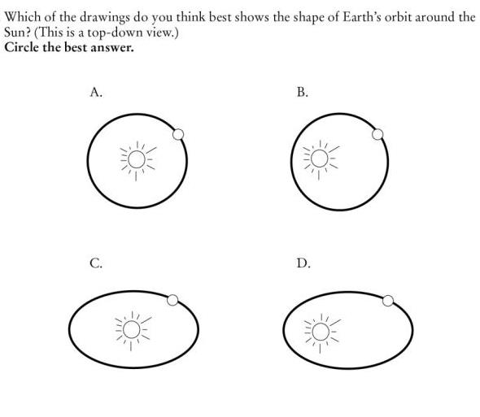
#
#
#
#
Notes:
Session 2.1: Pre-unit 2 Questionnaire: Why Are There Seasons?

Slide 6
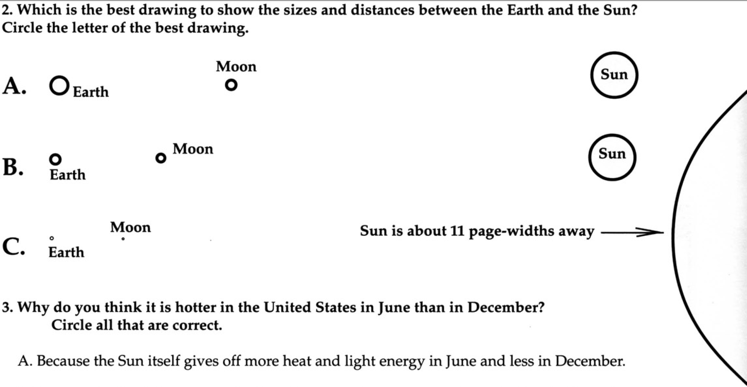
#
#
#

Slide 7
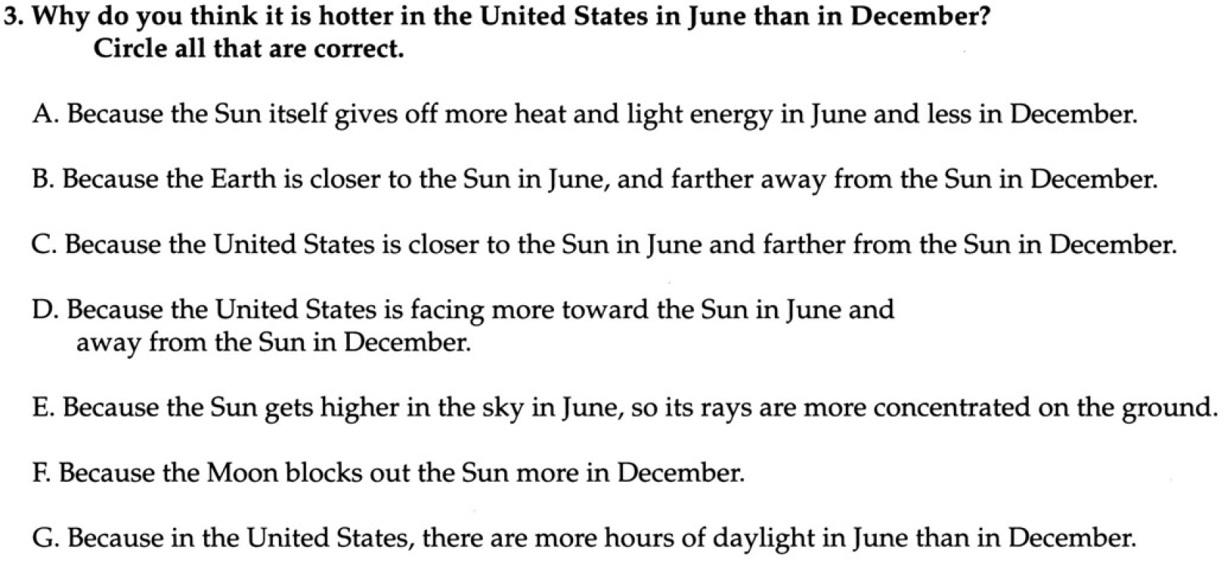
#
#
#
#
#
#
#

Slide 8
Activity 3: Trip to the Sun

Slide 9
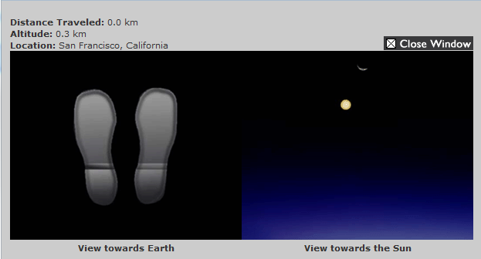

Slide 10
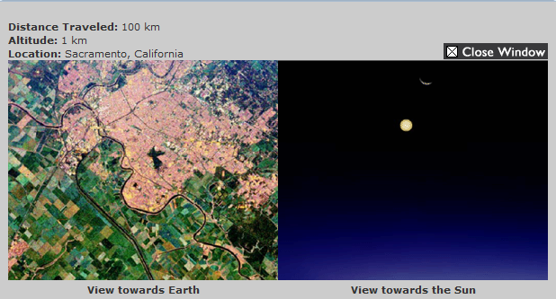

Slide 11
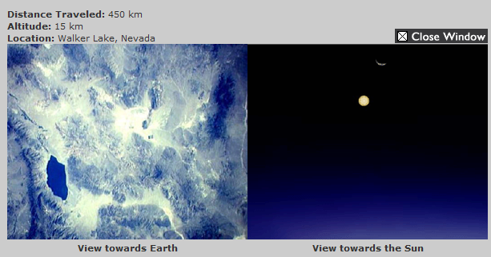

Slide 12
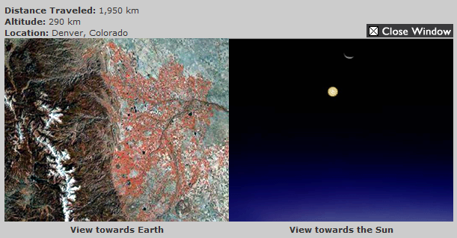

Slide 13
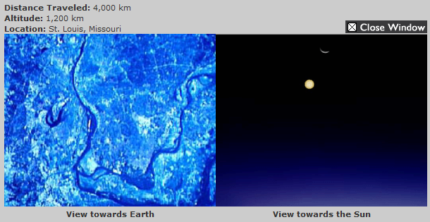

Slide 14
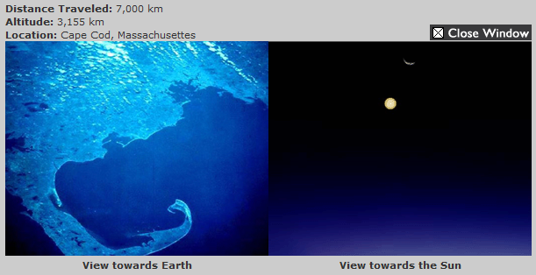

Slide 15
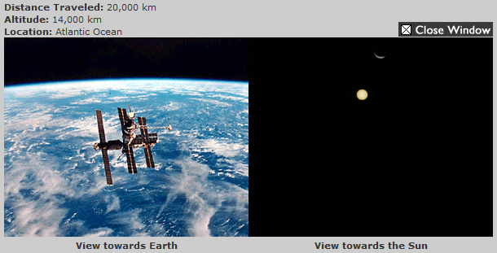

Slide 16
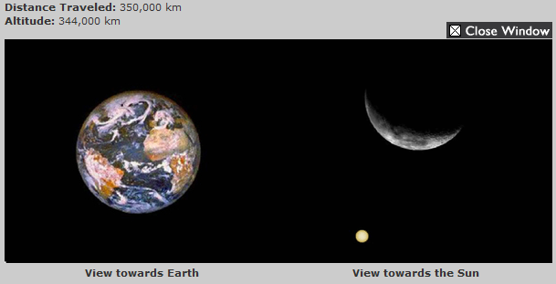

Slide 17
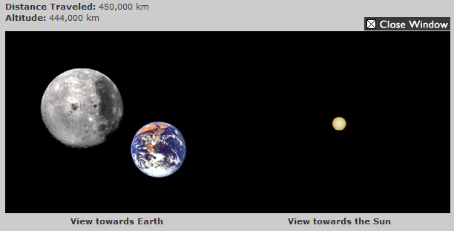

Slide 18
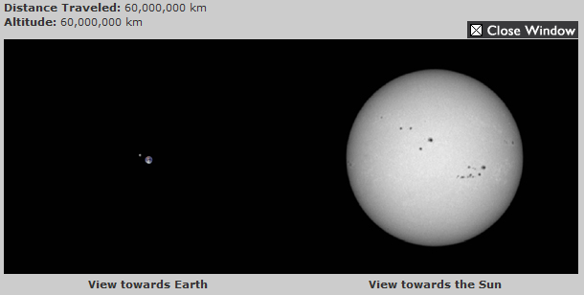

Slide 19
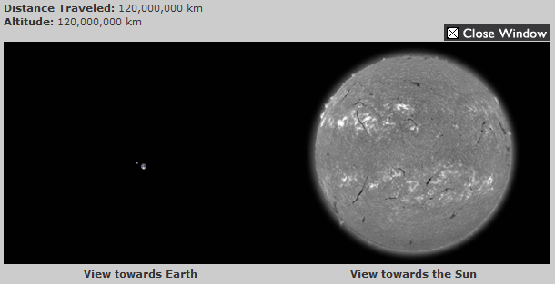

Slide 20
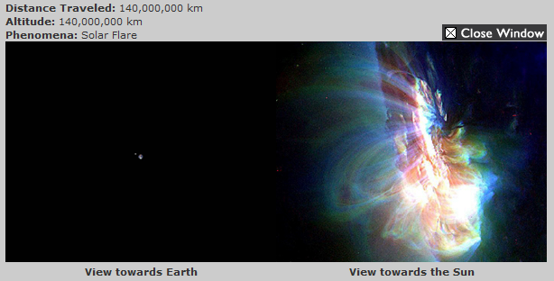

Slide 21
Activity 4: What Shape is Earth’s Orbit?

Slide 22
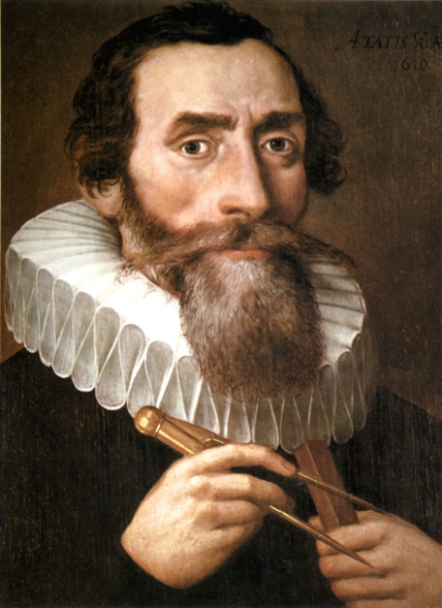
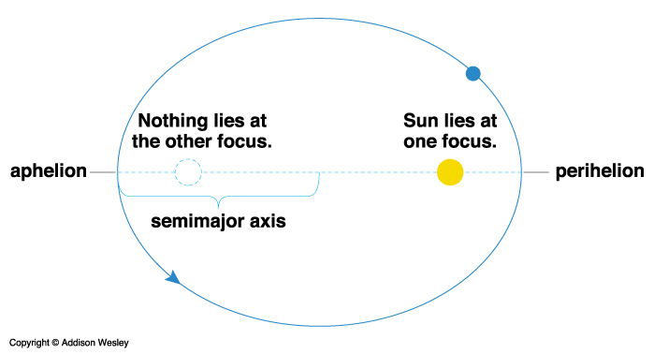
Johannes Kepler formulated 3 laws of planetary motion:
#1 - Planets move in elliptical orbits with the Sun at one focus of the ellipse.

Slide 23
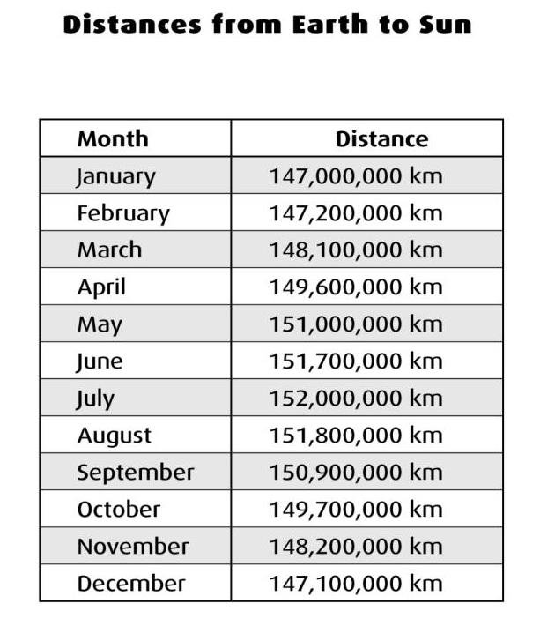
Notes:
Session 2.1: Distances from Earth to Sun

Slide 24
Scale for football field model:
1 yard = 2 million miles
10 yards = 20 million miles
50 yards = 100 million miles
Distance from the Earth to the Sun = 93 million miles
If the Sun is roughly 1 million miles in diameter,
how large should we make the Sun in this model?
One half yard
If the Earth is roughly 8,000 miles in diameter,
how large should we make the Earth in this model?
1/200 of a yard
Notes:
Have participants turn to football field model in their Activity 3 handout pack. Discuss the scale for the football field model. (click through questions on slide)

Slide 25
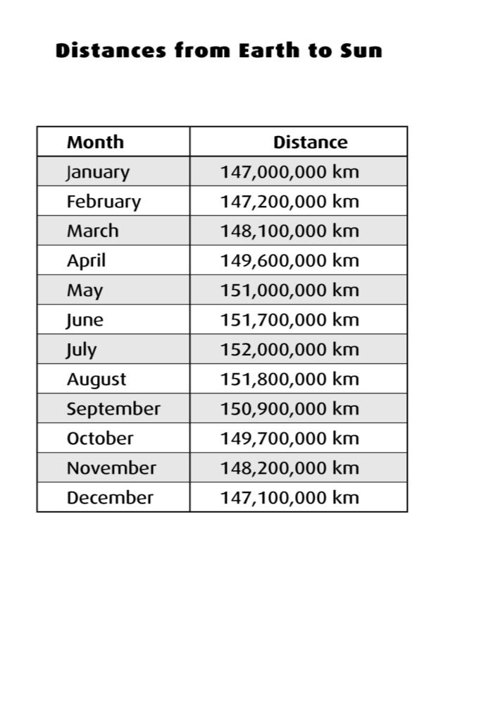
The change in distance is about 5,000,000
out of 150,000,000 or 3%
Notes:
Session 2.1: Distances from Earth to Sun– Quickly go through plotting the orbit of the earth on the football field model.
Sun on 50 yd line. (click)
Earth on 0 yd. Line (click)
Show distances from Earth to Sun transparency (click)
Jan already plotted– when putting Earth on 50 yd line. (click)
Plot April (click)
Plot July (click)
Plot October (click)
The change in distance is about 5,000,000 out of 150,000,000 or 3%, now let’s look at visual of orbit (click)
Show orbit (yellow circle)—nearly circular
Show an actual circle (blue) for comparison.
-- Re-address question 2. Talk about why children (And adults have the misconception that Earth’s orbit is elliptical, then do wooden hoop demonstration (pg. 286) with light from LCD projector to provide further proof about a nearly circular orbit can appear to be an ellipse depending on the viewing angle.

Slide 26
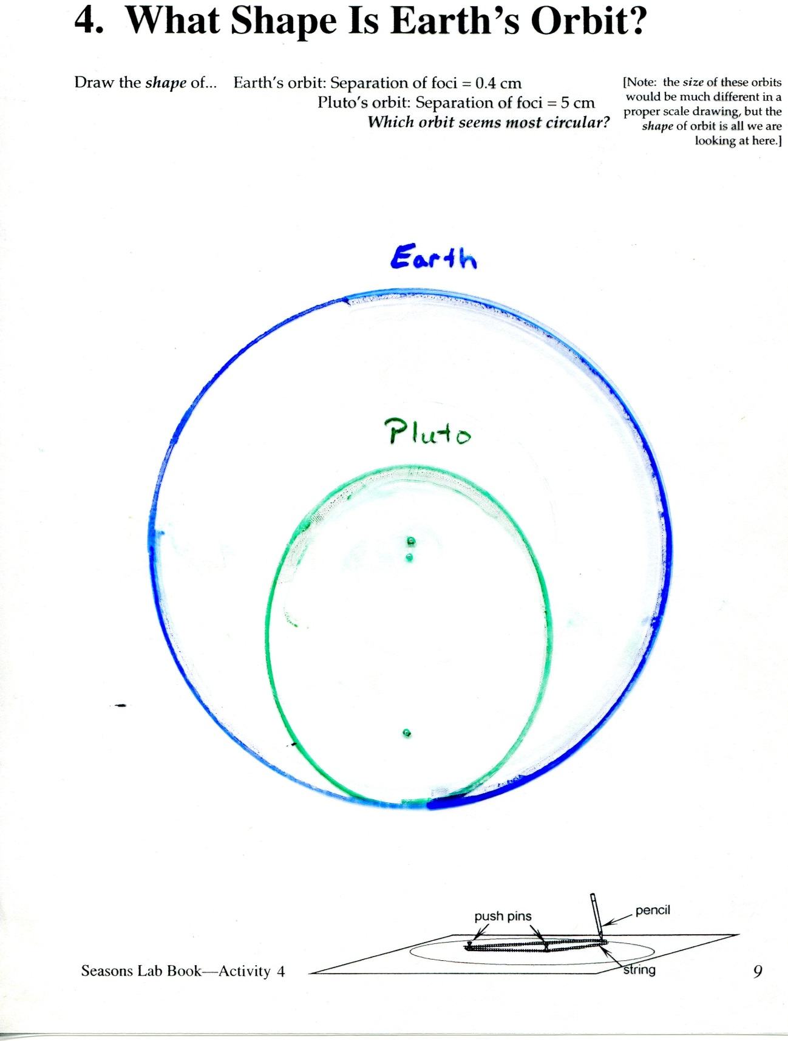

Slide 28
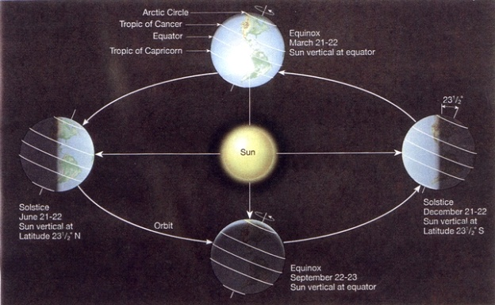

Slide 29
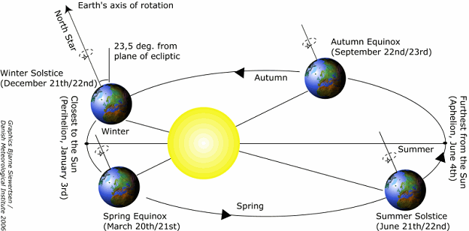

Slide 30
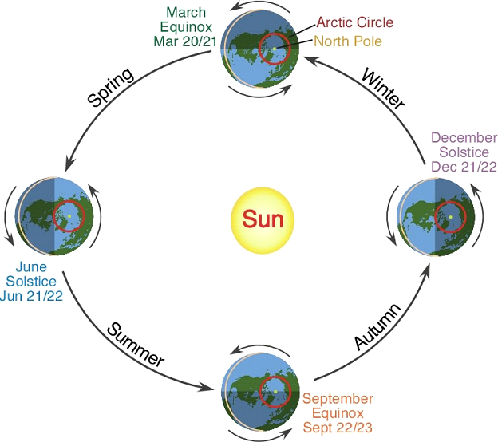

Slide 31
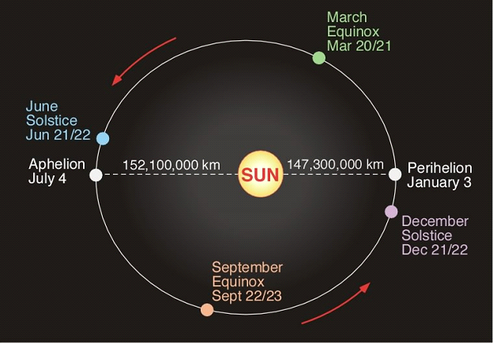
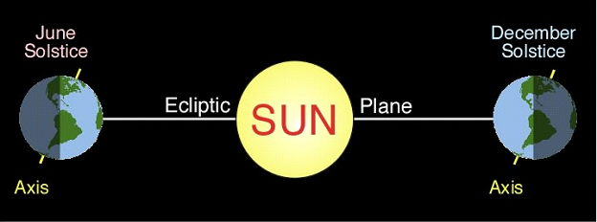

Slide 32
Activity 5: Temperatures Around the World

Slide 33
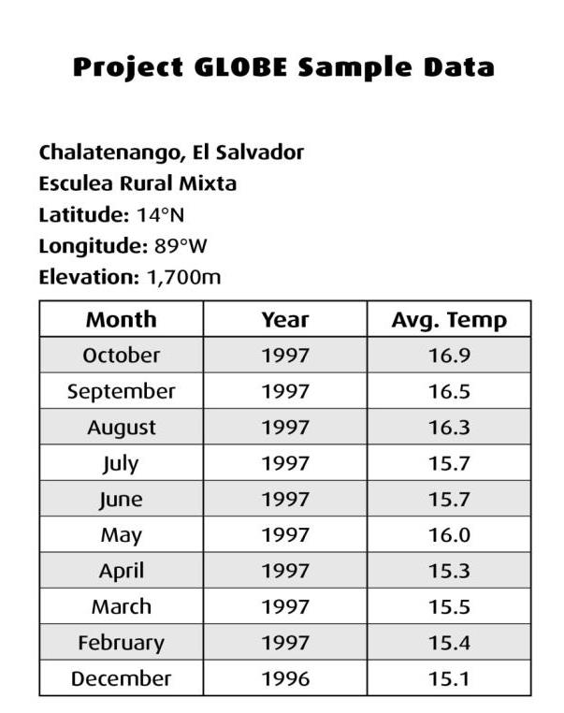
Notes:
Session 2.2: Project GLOBE sample data

Slide 34
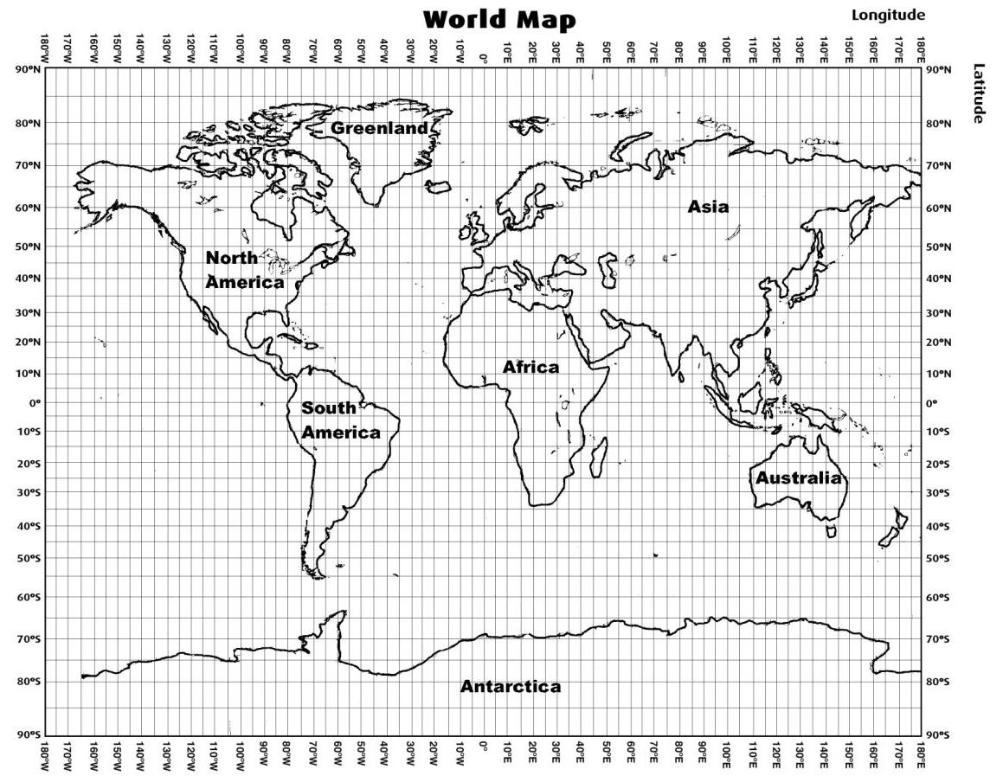
Notes:
Session 2.3: World Map

Slide 35
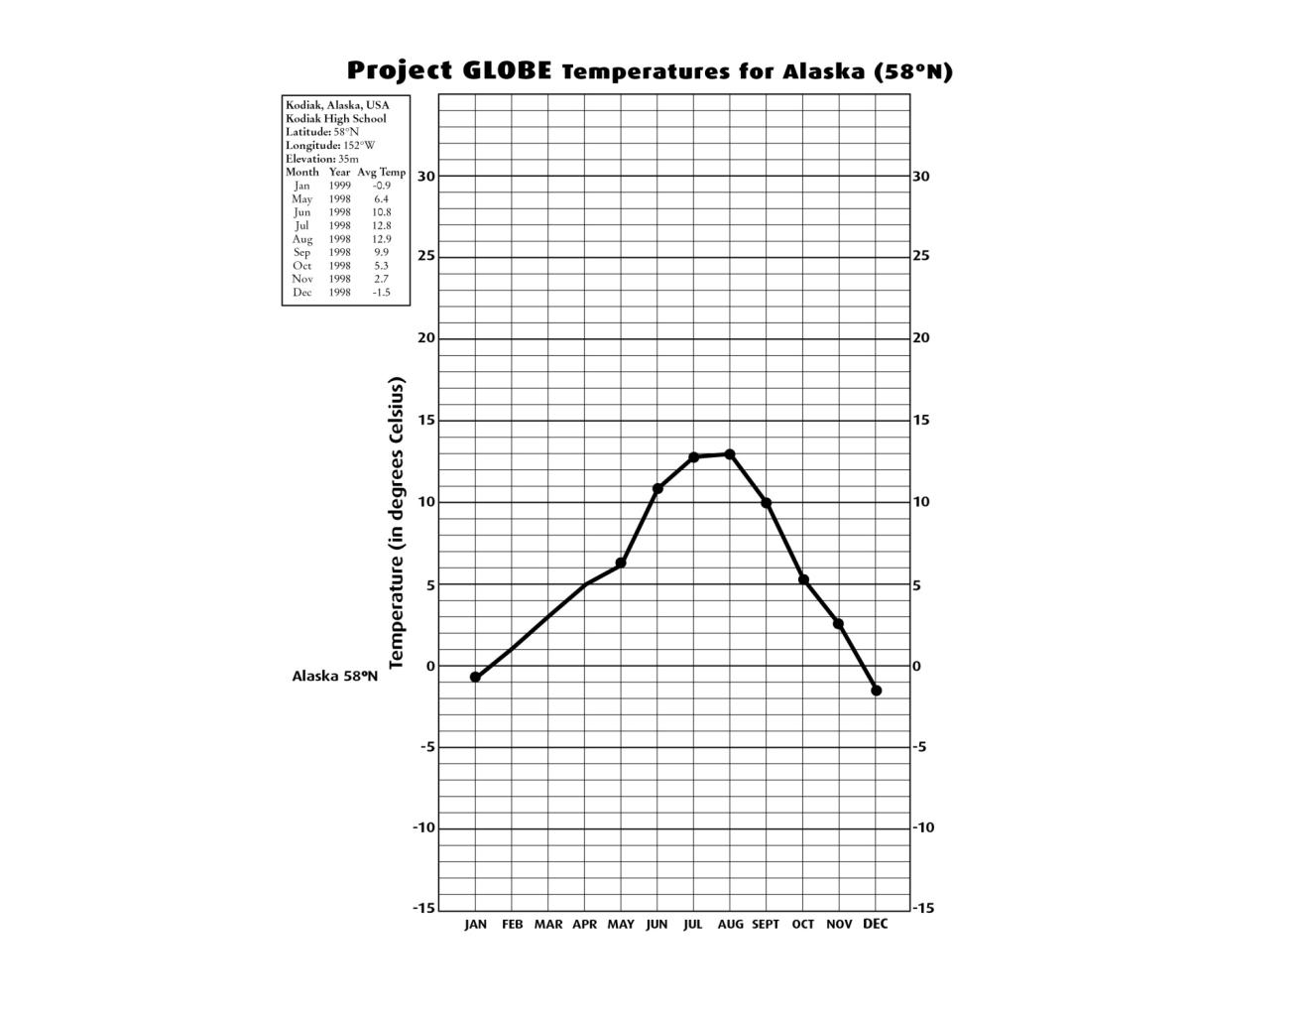
Notes:
Session 2.2: Project GLOBE Temperatures for Alaska

Slide 36
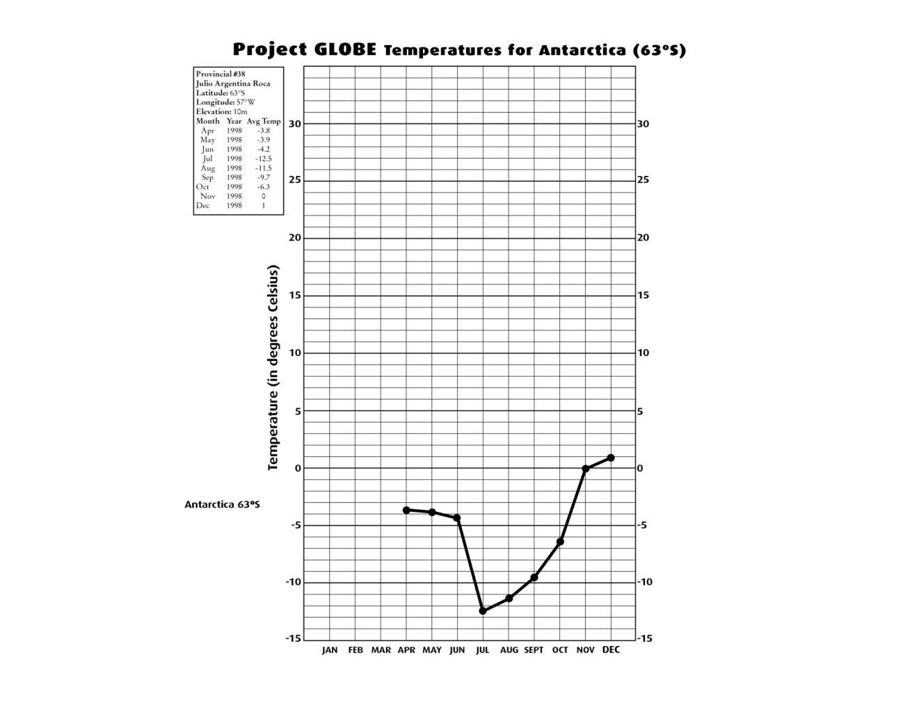
Notes:
Session 2.2: Project GLOBE Temperatures for Antarctica

Slide 37
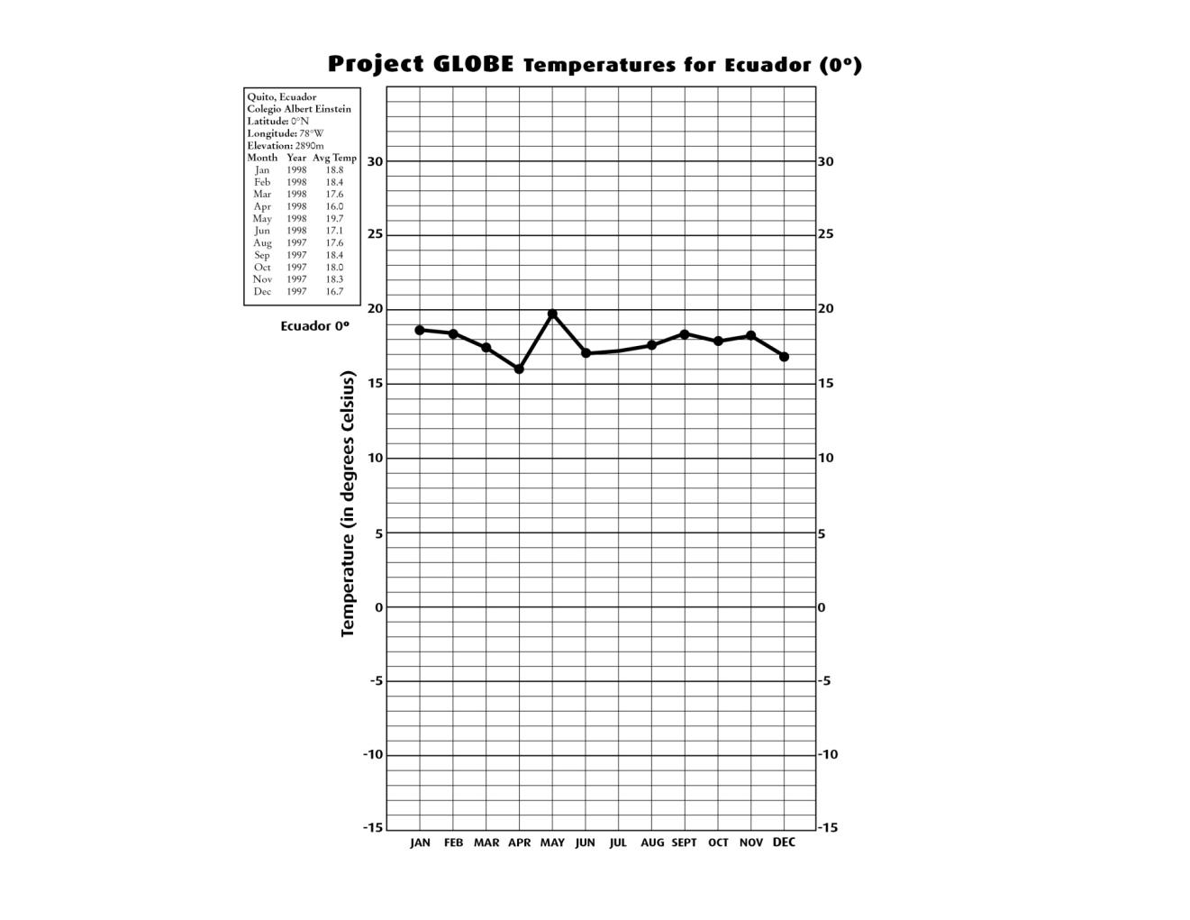
Notes:
Session 2.2: Project GLOBE Temperatures for Ecuador

Slide 38
Earth’s tilt does not significantly
change its distance from the Sun.
Scale size of Earth: 1mm
Scale size of Sun: 10 cm
Scale size of model: 1cm = 140,000 km
Distance from the Earth to the Sun ≈ 150,000,000 km
Scale distance between Earth and Sun ≈10 meters

Slide 39
Activity 6: Days and Nights Around the World

Slide 40
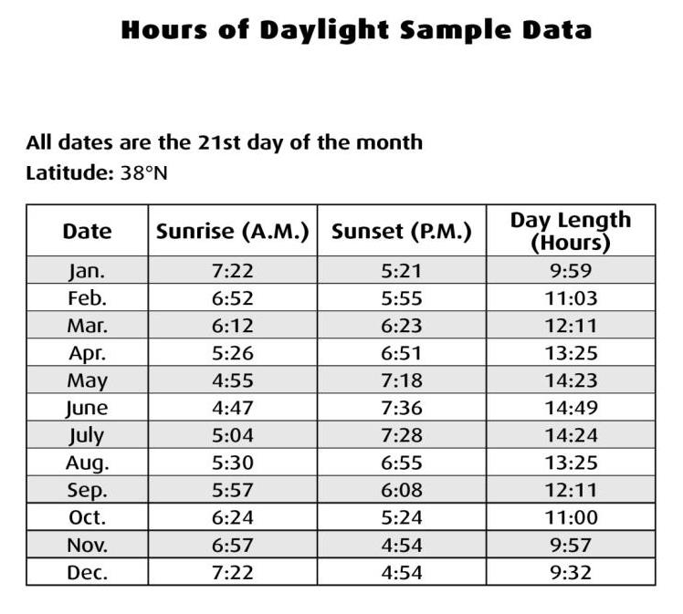
Notes:
Session 2.3: Hours of Daylight Sample Data

Slide 41
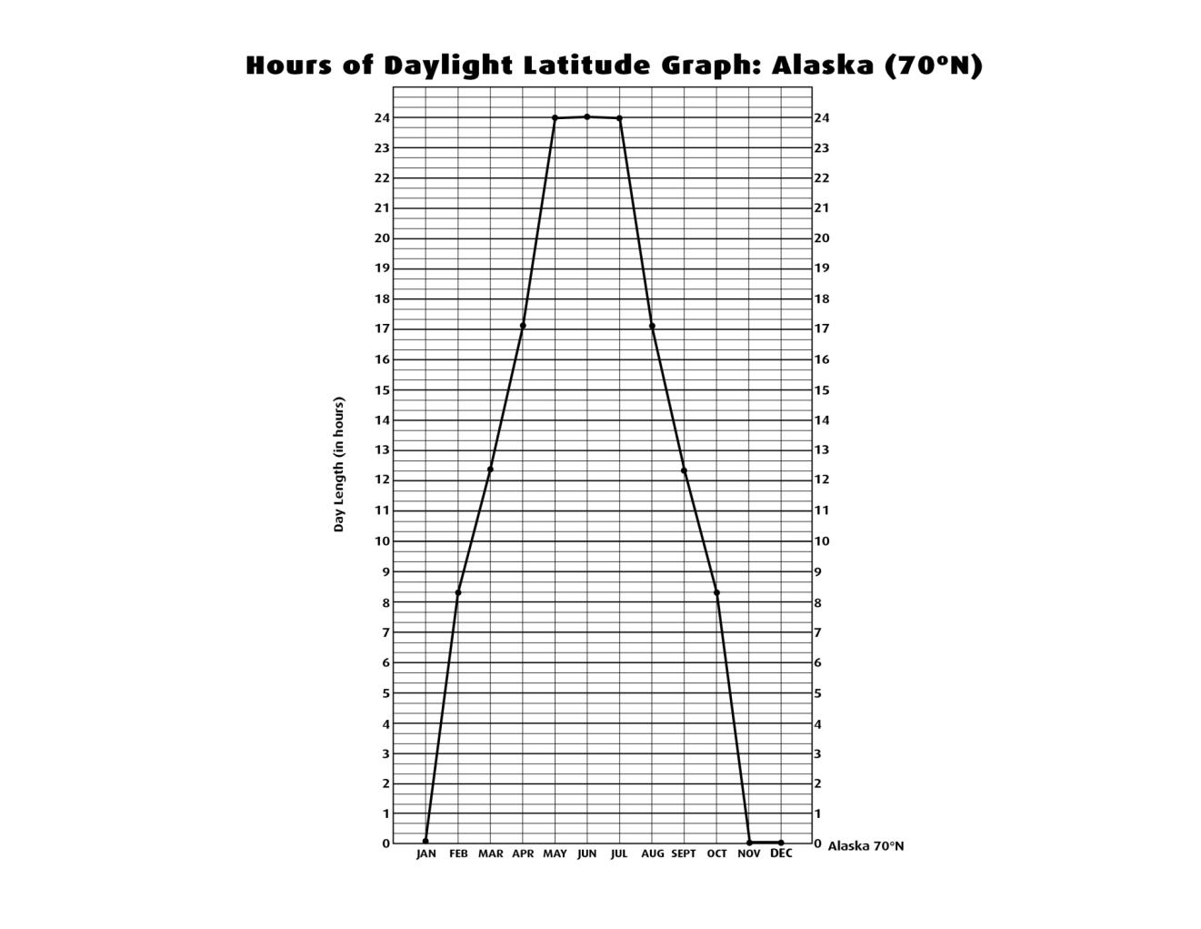
Notes:
Session 2.3: Hours of Daylight Latitude Graph: Alaska

Slide 42
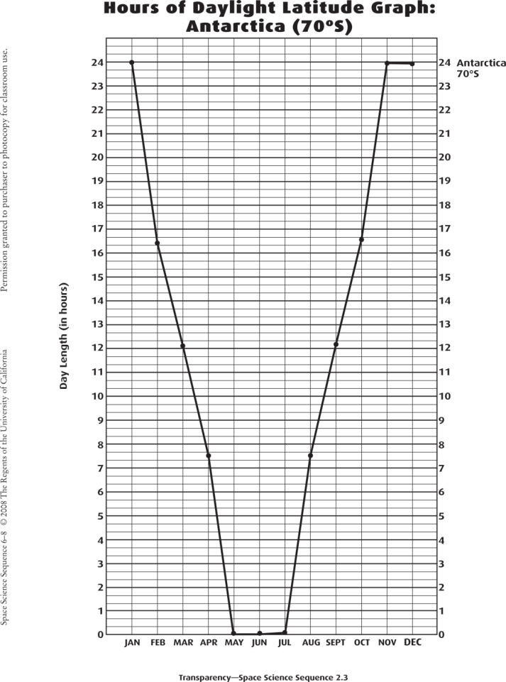
Notes:
Session 2.3: Hours of Daylight Latitude Graph: Alaska

Slide 43
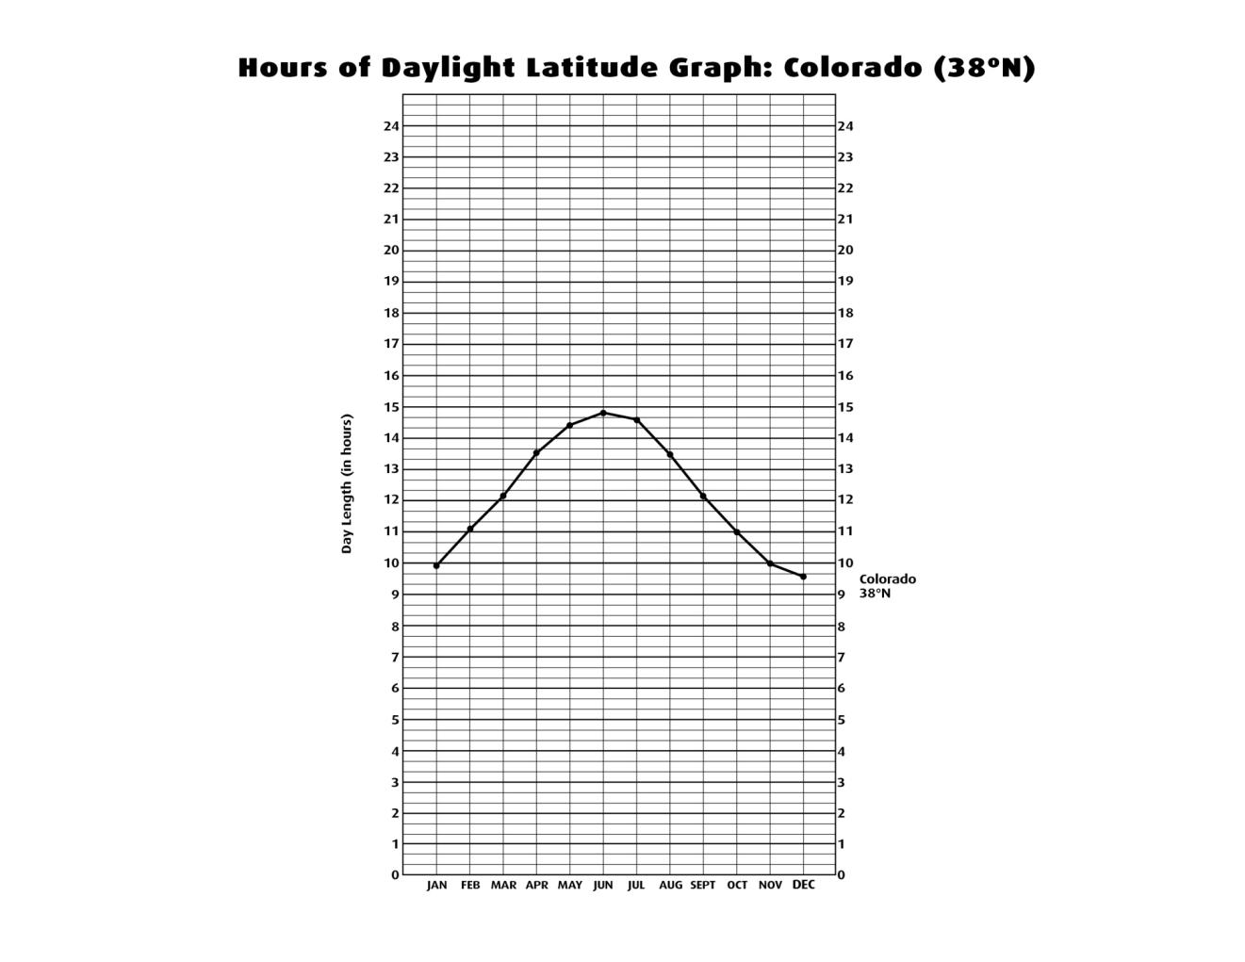
Notes:
Session 2.3: Hours of Daylight Latitude Graph: Colorado

Slide 44
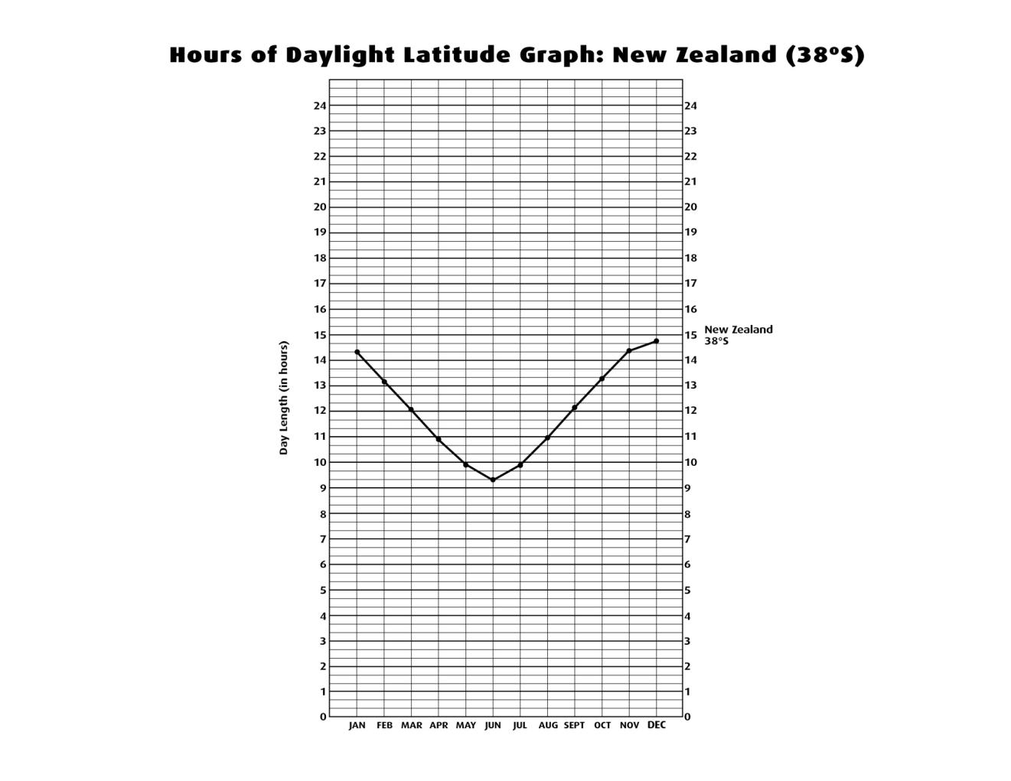
Notes:
Session 2.3: Hours of Daylight Latitude Graph: New Zealand

Slide 45
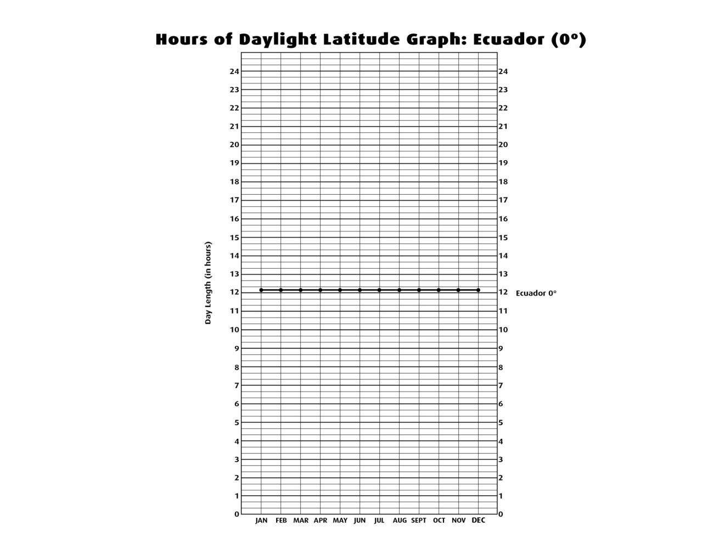
Notes:
Session 2.3: Hours of Daylight Latitude Graph: Ecuador

Slide 46
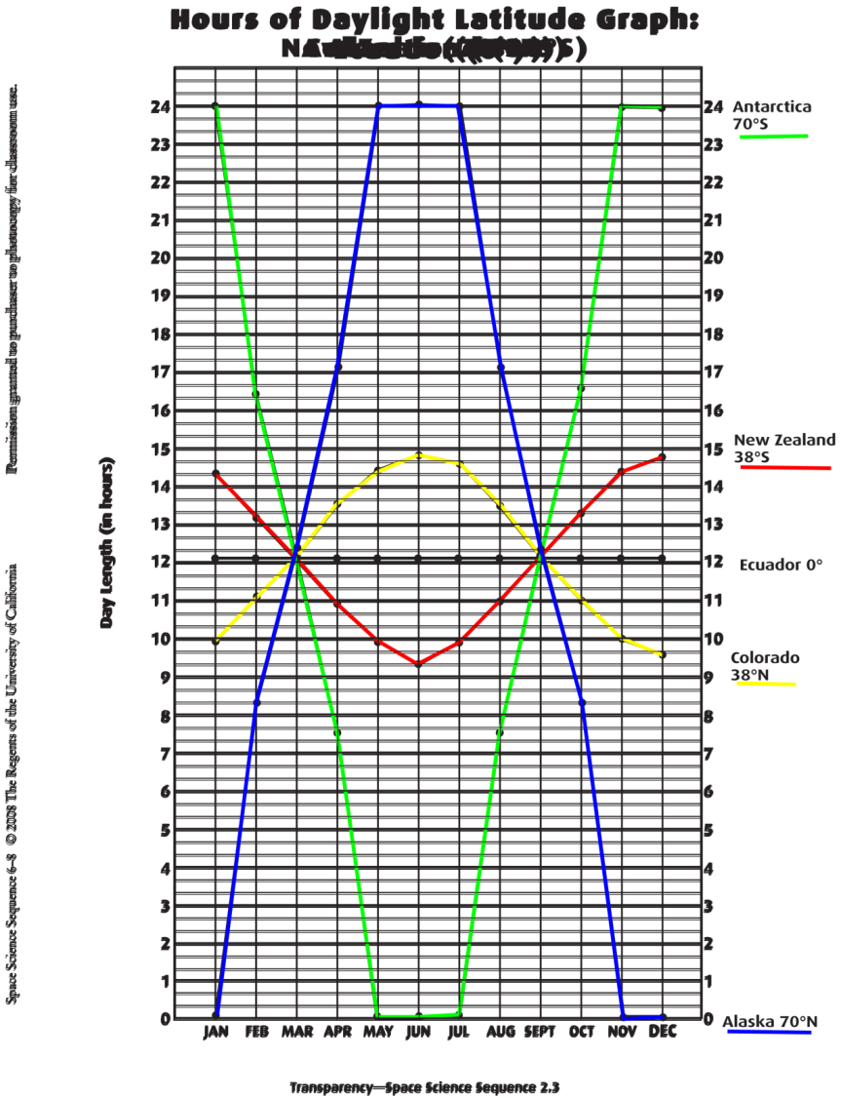

Slide 47
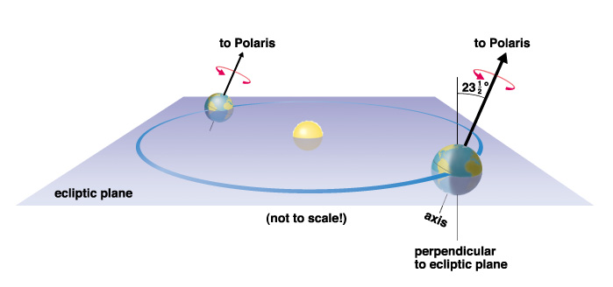
Activity 7: Tilted Earth

Slide 48
Activity 8:
Seasons Unraveled/The Angle of Sunlight

Slide 49
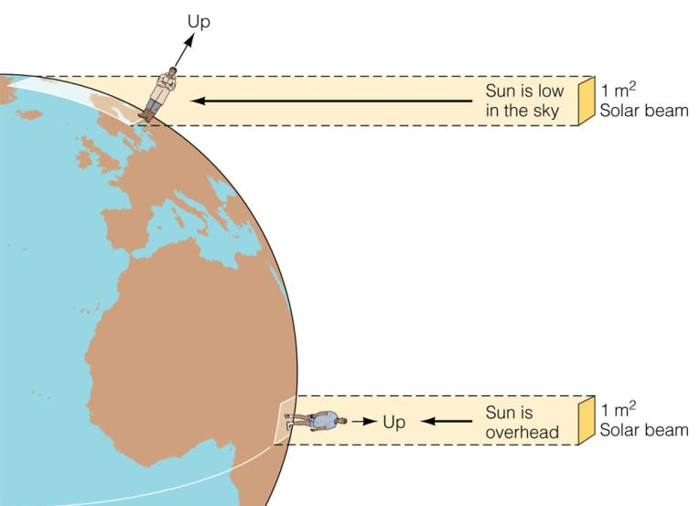
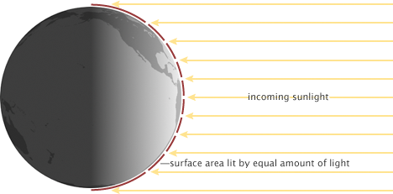
Intensity of Sunlight depends strongly on the angle of incidence
When the Sun is high in the sky, the angle of incidence is small (more direct), and energy is more concentrated on the ground.
When the Sun is low in the sky, the angle of incidence is big (less direct), and energy is more spread out on the ground.

Slide 50
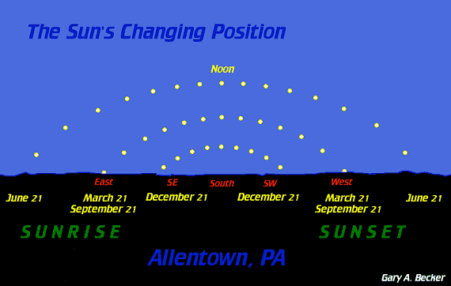
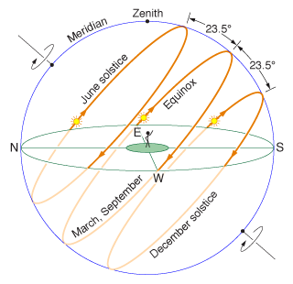
The angle of the Sun changes with the seasons.
The Sun reaches it maximum height in the sky in the Summer
The Sun reaches it minimum height in the sky in the Winter

Slide 51
Variation in brightness (intensity) of Sun at noon due to distance and angle
Distance
Perihelion: 147,095,271 km
Aphelion: 152,091,174 km
b_{p}/b_{a} = (d_{a}/d_{p})² = 1.069 → 6.9% variation
Angle
for tropics: noon angle ranges from 0° from zenith (directly overhead) to 47° (23.5 + 23.5) from zenith.
b_{s}/b_{w} = cos(0)/cos(47) = 1.466 → 46.6% variation
Daylight Hours (tropics)
13.567h – 10.667h → 27.1% variation

Slide 52
Notes:
Session 2.1: Pre-unit 2 Questionnaire: Why Are There Seasons?

Slide 54
Common Misconceptions
The Earth’s orbit is highly elliptical or oval
The Earth is closer to the Sun in the summer
The Earth’s tilt causes the seasons because the tilted part is closer to the Sun
Direct rays of sunlight hit the Earth at 90º angles. Indirect rays of sunlight hit the Earth at angles less than 90º.

