Slide 1
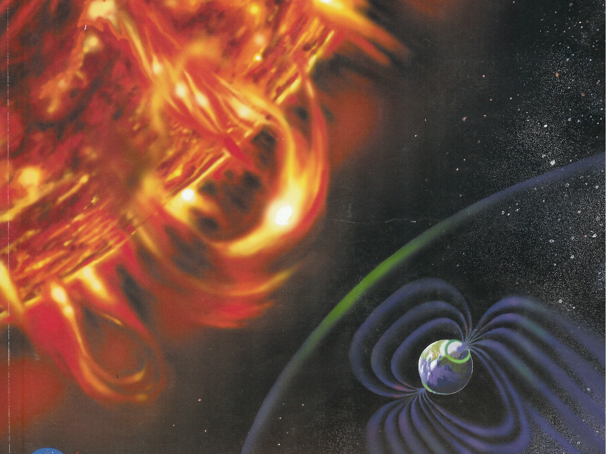
Living with a Star
From Sunscreen to Space Weather

Slide 2
Activity 1: The Mystery

Slide 3
Jan 25 | Jan 26 | Jan 27 | Jan 28 | Jan 29 | Jan 30 | Jan 31
Radio Communications Lost (3:18 pm PDT): -geologists in mountains -air traffic At 3:18pm radiation on the ISS 4:20pm contact regains 9:00pm long distance radio disrupted |  | Blackouts: NYC, BOS. SEA Unusual clouds of color & light toward LA TV disrupted for 2 hours Magnetic North shifted Cell phones out in the west | Still no cell phones NYC still under blackout Magnetic North returns | Blackout in NYC continues Unseasonably cold weather in NYC - deaths Cell phones are back!!!! |  | Power restored in NYC

Slide 4
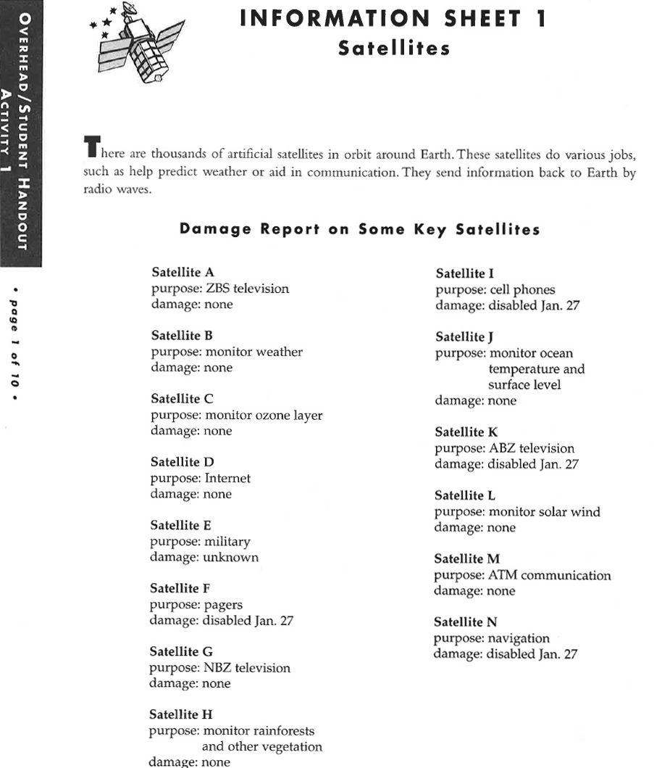
Notes:
Session 1.1: Satellite Information Sheet

Slide 5
Activity 2: Energy From The Sun

Slide 6
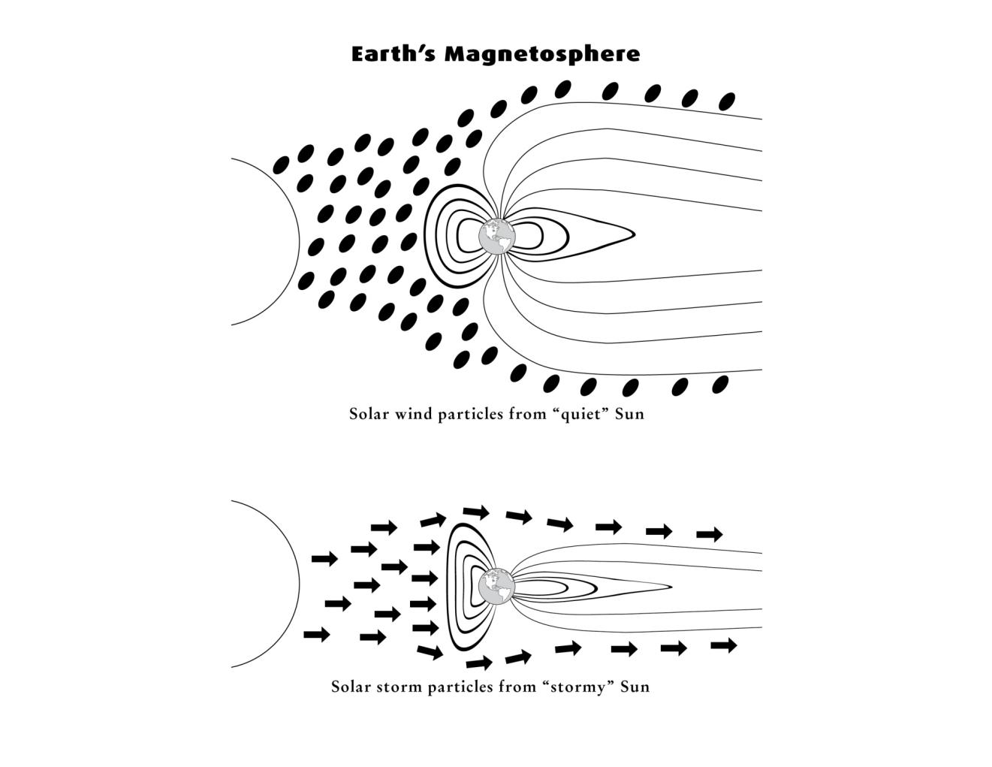
Notes:
Session 1.5: Earth’s Magnetosphere

Slide 7
Activity 3: Balloon/Rocket Mission

Slide 8
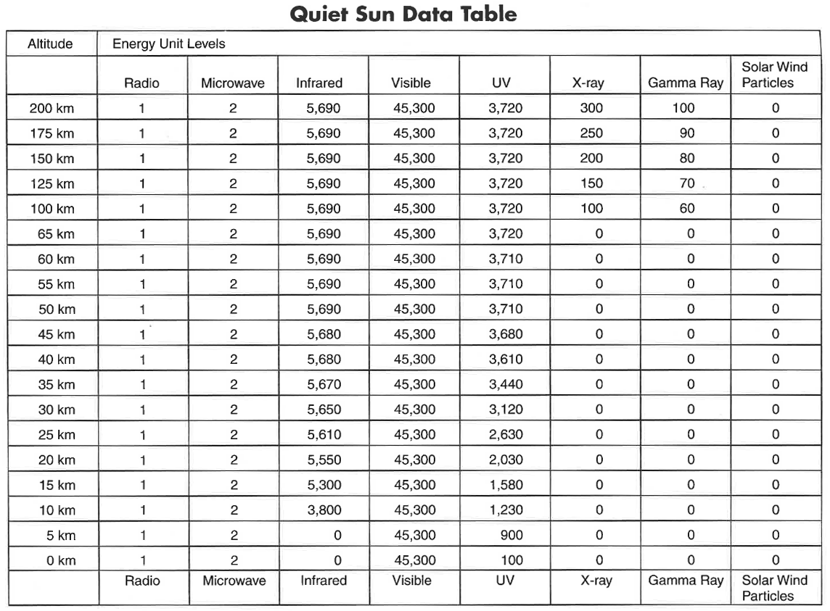
Notes:
Session 1.5: Data for the Balloon-Rocket Mission

Slide 9
Notes:
Session 1.5: Data for the Balloon-Rocket Mission

Slide 10
Notes:
Session 1.5: Data for the Balloon-Rocket Mission

Slide 11
Notes:
Session 1.5: Data for the Balloon-Rocket Mission

Slide 12
Notes:
Session 1.5: Data for the Balloon-Rocket Mission

Slide 13
Notes:
Session 1.5: Data for the Balloon-Rocket Mission

Slide 14
Notes:
Session 1.5: Data for the Balloon-Rocket Mission

Slide 15
Notes:
Session 1.5: Data for the Balloon-Rocket Mission

Slide 16
Notes:
Session 1.5: Data for the Balloon-Rocket Mission

Slide 17
Notes:
Session 1.5: Data for the Balloon-Rocket Mission

Slide 18
Notes:
Session 1.5: Data for the Balloon-Rocket Mission

Slide 19
Notes:
Session 1.5: Data for the Balloon-Rocket Mission

Slide 20
Notes:
Session 1.5: Data for the Balloon-Rocket Mission

Slide 21
Notes:
Session 1.5: Data for the Balloon-Rocket Mission

Slide 22
Notes:
Session 1.5: Data for the Balloon-Rocket Mission

Slide 23
Notes:
Session 1.5: Data for the Balloon-Rocket Mission

Slide 24
Notes:
Session 1.5: Data for the Balloon-Rocket Mission

Slide 25
Notes:
Session 1.5: Data for the Balloon-Rocket Mission

Slide 26
Notes:
Session 1.5: Data for the Balloon-Rocket Mission

Slide 27
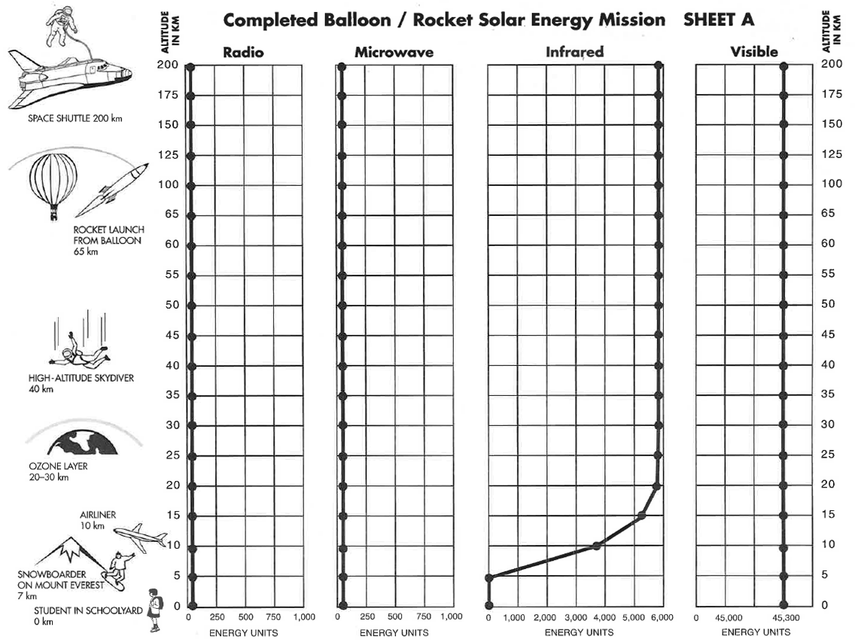
Notes:
Session 1.5: Completed Balloon-Rocket Mission Graphing Sheet - Solar Particles

Slide 28
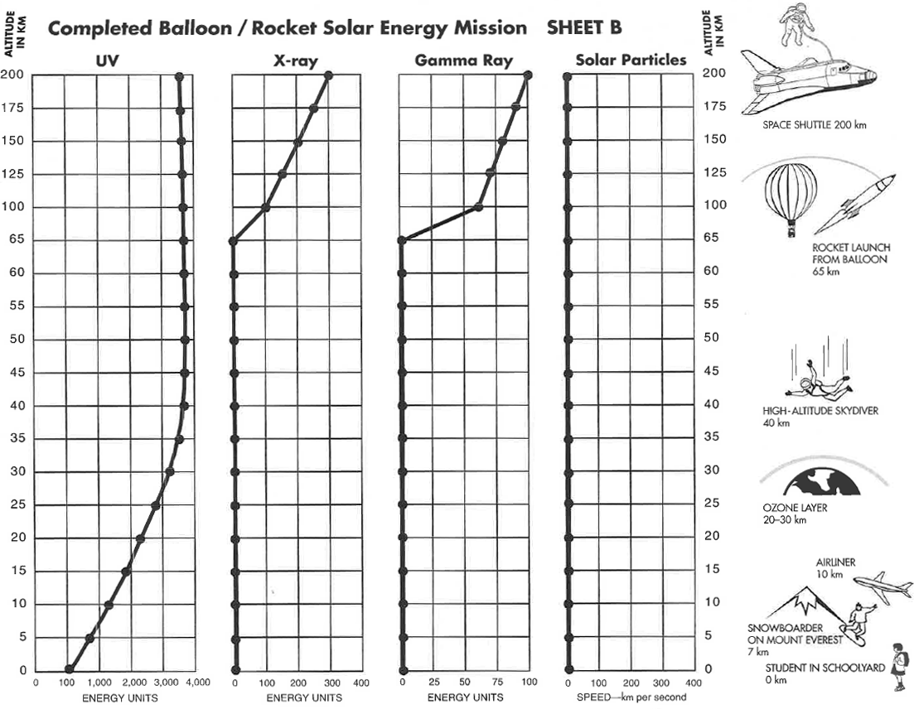

Slide 29
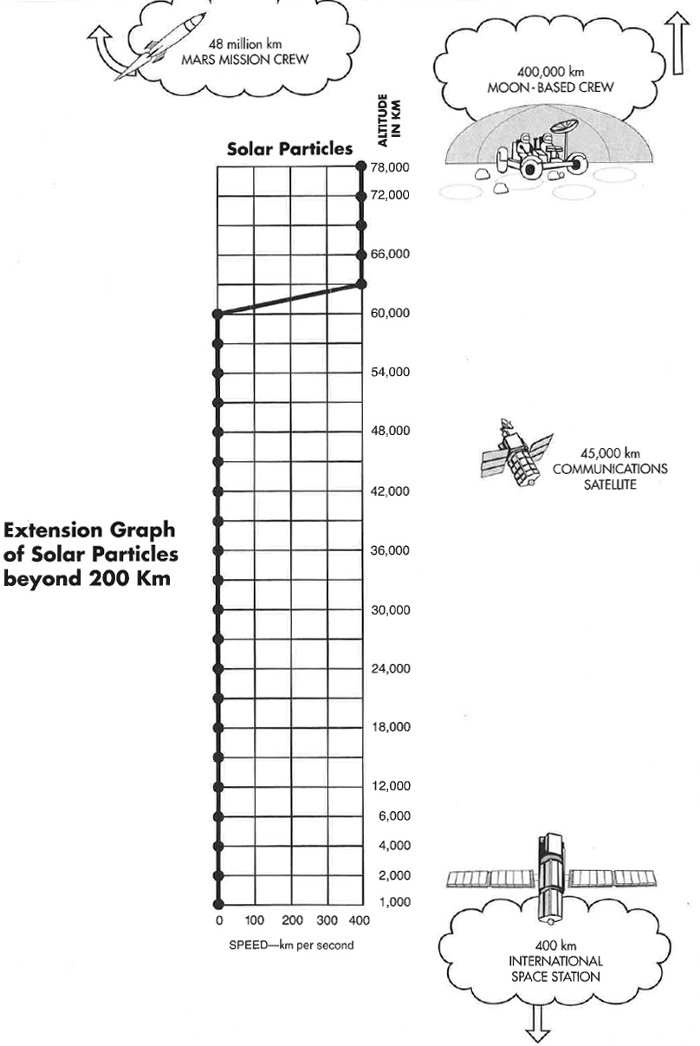
Notes:
Session 1.5: Extension Graph of Solar Particles

Slide 30
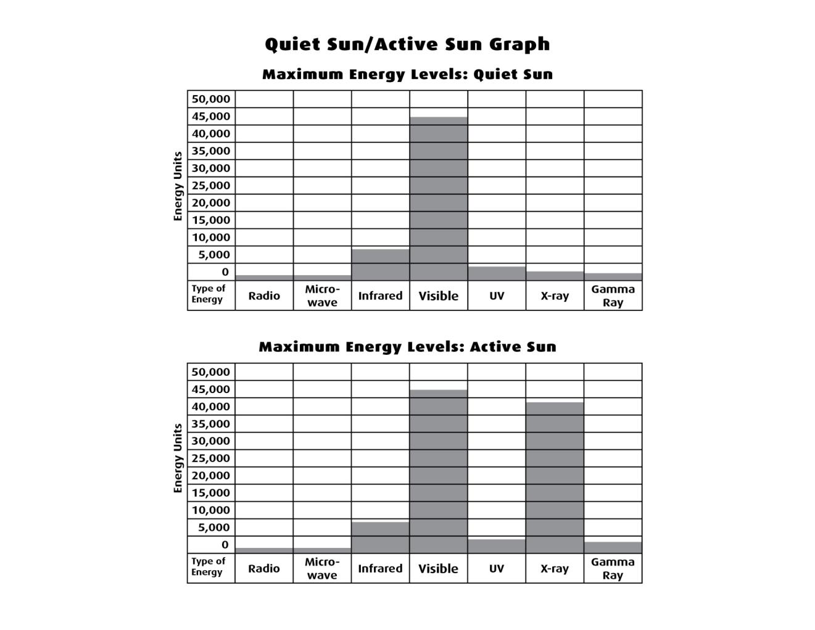
Notes:
Session 1.4: Quiet Sun/Active Sun Graph

Slide 31
Activity 4: Ultraviolet Experiments

Slide 32
Type of UV | UV-A | UV-B | UV-C
Uses | Skin tanning, black lights, invisible stamps | Stimulates skin to produce Vitamin D | Sterilization, disinfection
Harmful Effects | May contribute to skin cancer and aging of cells | Sunburn, skin cancer, eye damage, such as cataracts | Lethal to all living things
Shielding | Most blocked by stratosphere | Most blocked by stratosphere | All blocked by stratosphere

